Slide 1
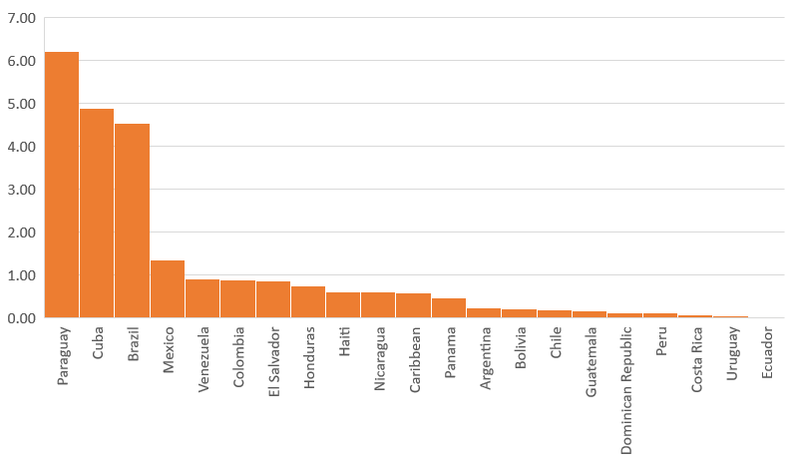
Notification rate of suspected measles and rubella cases per 100,000 population
by country. Latin America and the Caribbean, 2017-2020*
Country | Rate of suspected cases 2019 | Rate of suspected cases 2018 | Rate of suspected cases 2017
Brazil | 31.6 | 5.4 | 0.9
Cuba | 28.9 | 22.9 | 12.5
Paraguay | 22.3 | 13.0 | 8.0
Nicaragua | 10.5 | 4.4 | 3.7
El Salvador | 8.6 | 8.1 | 4.3
Caribbean | 4.7 | 4.5 | 2.3
Chile | 4.2 | 3.2 | 1.0
Colombia | 4.1 | 13.4 | 2.6
Mexico | 4.0 | 3.2 | 2.7
Guatemala | 2.1 | 3.0 | 1.1
Venezuela | 2.1 | 27.7 | 4.4
Uruguay | 2.1 | 0.41 | 0.1
Costa Rica | 2.0 | 1.32 | 2.1
Honduras | 4.0 | 2.2 | 1.7
Dominican Republic | 1.62 | 1.73 | 3.2
Haiti | 1.85 | 1.91 | 1.5
Peru | 1.71 | 3.7 | 1.0
Panama | 1.58 | 1.65 | 1.2
Bolivia | 1.44 | 2.2 | 0.6
Ecuador | 1.00 | 6.0 | 2.2
Argentina | 0.67 | 4.6 | 0.8
Rate of suspected cases by country epidemiological weeks (EW) 1-20 of 2020
Expected rate EW 20 | 0.77
Regional rate EW 20 | 2.10
Rate of the last 52 weeks | 12.2
>2.00 x 100,000 habitantes
1.00-1.99 x 100,000 habitantes
Source: Weekly surveillance reports through ISIS, MESS y Excel to FPL-IM/PAHO *Data as of EW- 20, 2020
<0.99 x 100,000 habitantes

