Slide 1
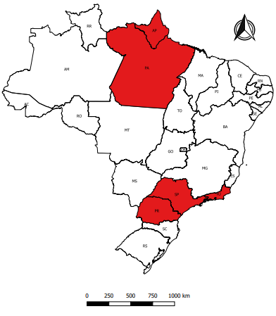
Measles outbreak in Brazil, 2020^{(a)}
Brazil reported 7,718 confirmed measles cases in 2020; of this total, 65% were in the state of Pará.
Five states (Amapá, Pará, Paraná, Rio de Janeiro and São Paulo) reported ongoing virus circulation in the last 90 days.
Infants aged <1 year old reported the highest incidence rate (104,00 cases per 100,0000 population), followed by young adults aged 15 to 19 years old and 20 to 29 years old, though this last group reported the highest proportion of confirmed cases.
Five deaths were reported in children <5 years old, in three states.
The country has scheduled a multi-antigen vaccination campaing in October of this year, targeting individuals <15 years old nationwide.
Genotype D8, lineage GirSomnath was isolated.
^{b}
Ongoing measles virus circulation
Source: Health Secretariat, Ministry of Health of Brazil. ^{A} Data until the Epidemiological week 32, updated in 17/08/2020, subject to change

