Slide 1
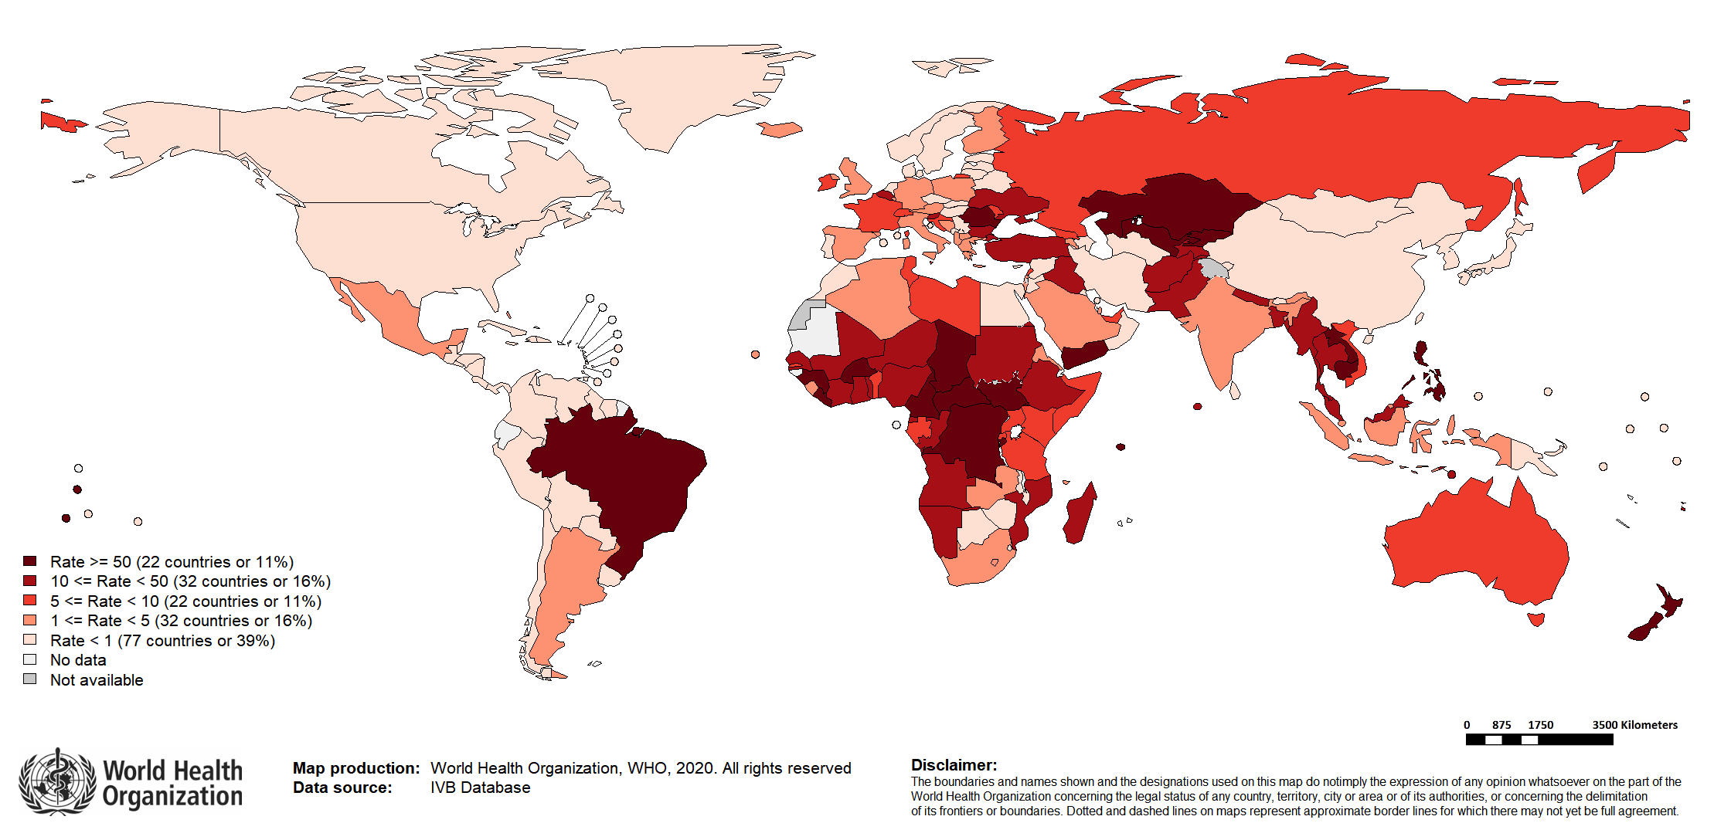
Measles Incidence Rate per Million: last 12 months*
Top 10** | Top 10** | Top 10**
Country | Cases | Rate
DR Congo | 22825 | 263.18
Brazil | 19992 | 94.13
Nigeria | 8009 | 39.85
Philippines | 6984 | 64.6
India**** | 6827 | 4.99
Bangladesh | 6004 | 35.72
Kazakhstan | 5529 | 297.37
Uzbekistan | 5034 | 153.44
Central African Republic | 4638 | 961.1
Ethiopia | 2808 | 25.5
Other countries with high incidence rates*** | Other countries with high incidence rates*** | Other countries with high incidence rates***
Country | Cases | Rate
Tonga | 34 | 308.98
Seychelles | 28 | 292.57
New Zealand | 1195 | 249.35
Samoa | 47 | 236.29
Chad | 2456 | 155.3
Liberia | 665 | 133.6
Notes: Based on data received 2020-10 and covering the period between 2019-09 and 2020-08 - Incidence: Number of cases / population* * 1,000,000 - * World population prospects, 2019 revision - ** Countries with the highest number of cases for the period - *** Countries with the highest incidence rates (excluding those already listed in the table above) - ****WHO classifies all suspected measles cases reported from India as measles clinically compatible if a specimen was not collected as per the algorithm for classification of suspected measles in the WHO VPD Surveillance Standards. Thus numbers might be different between what WHO reports and what India reports.

