Slide 1
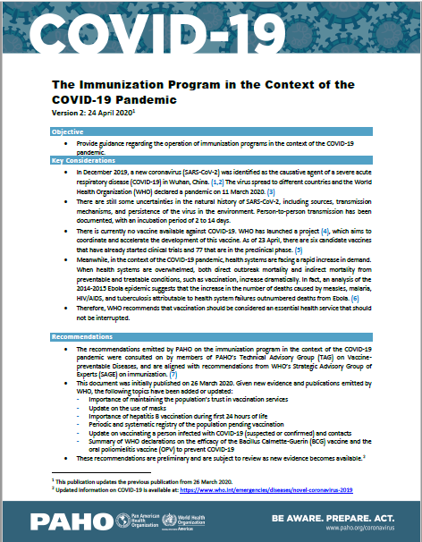
Surveillance systems should continue with early detection and case management for diseases with global surveillance mandates and elimination and eradication objectives: measles, rubella, neonatal tetanus, polio.
Optimizing and prioritizing the use of laboratory tests to ensure the sustainability of laboratory surveillance during the pandemic and in the months immediately following.
If an outbreak occurs, the risk-benefit of conducting outbreak response vaccination should be evaluated while considering the health system's ability to safely carry out this activity. This evaluation should assess the risk of a late response against the associated risks of an immediate response.
https://www.paho.org/en/documents/immunization-program-context-covid-19-pandemic-version-2-24-april-2020

