Slide 1
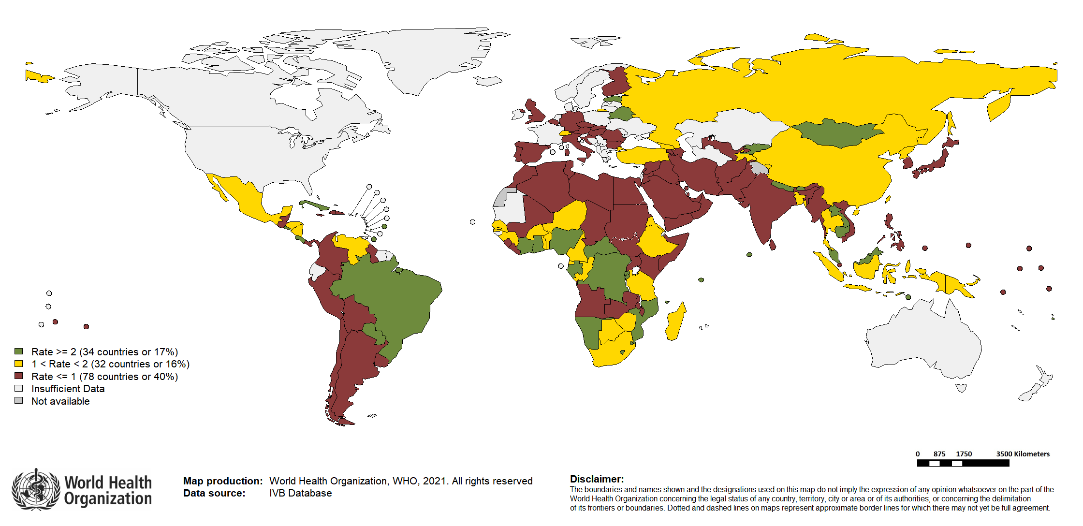
Surveillance sensitivity: global annual rate of suspected measles and rubella cases per 100,000 population, 2020*
Sensitivity of surveillance continues to be a challenge, with only 34 Member States achieving the annual rate target of 2/100,000 nationally, meaning there are many more measles and rubella cases out there than reported in 2020.
*Data reported to WHO as of February 2021. World population prospects, 2019 revision

