Slide 1
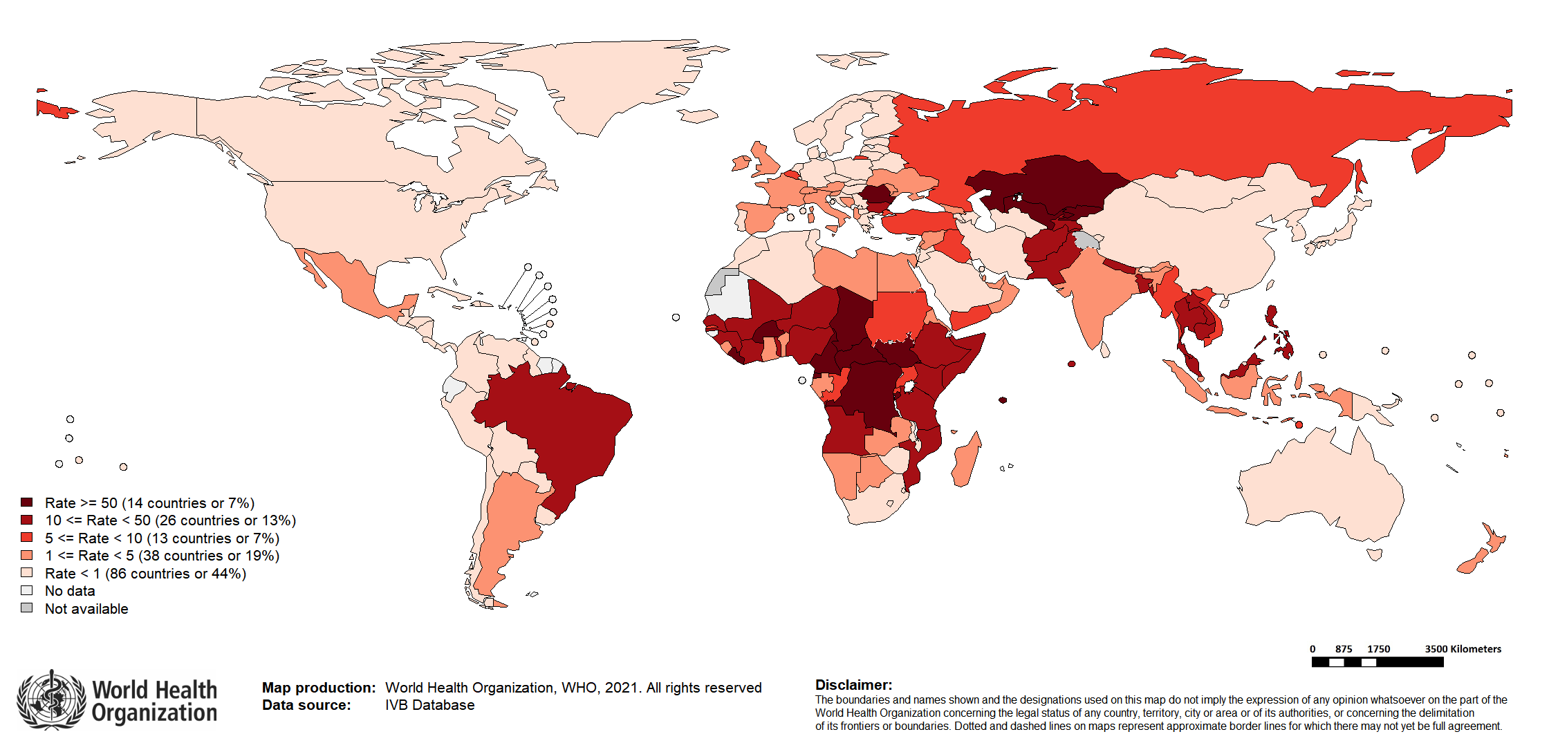
Global Measles Incidence Rate per Million Population, 2020*
Top 10** | Top 10** | Top 10**
Country | Cases | Rate
DR Congo | 15,095 | 168.65
Nigeria | 10,222 | 49.58
Brazil | 8,427 | 39.4
India*** | 5,444 | 3.94
Uzbekistan | 4,053 | 121.95
Philippines | 3,763 | 34.3
Central African Republic | 3,427 | 696.42
Kazakhstan | 3,269 | 174.09
Pakistan | 2,280 | 10.94
Chad | 2,170 | 133.25
* Based on data received 2021-02 ** Countries with the highest number of cases for the period ***WHO classifies all suspected measles cases reported from India as measles clinically compatible if a specimen was not collected as per the algorithm for classification of suspected measles in the WHO VPD Surveillance Standards. Thus, numbers might be different between what WHO reports and what India reports.

