Slide 1
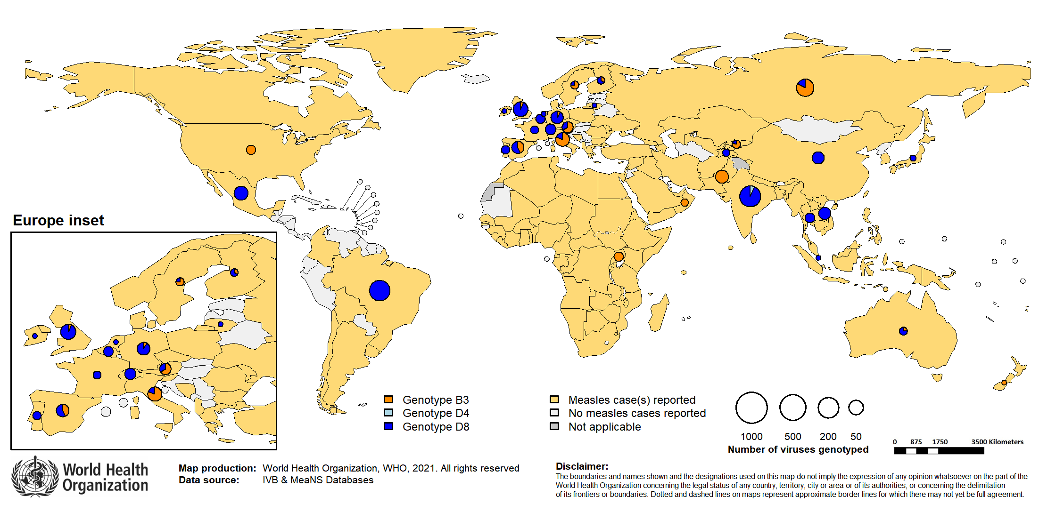
Distribution of measles genotypes in 2020*
Notes: Data Source: MeaNS database (Genotypes) and IVB Database (Incidence) as of 2021-02-12 and covering the period 2020-01-01 to 2020-12-31 - Pie charts proportional to the number of sequenced viruses

