Slide 1
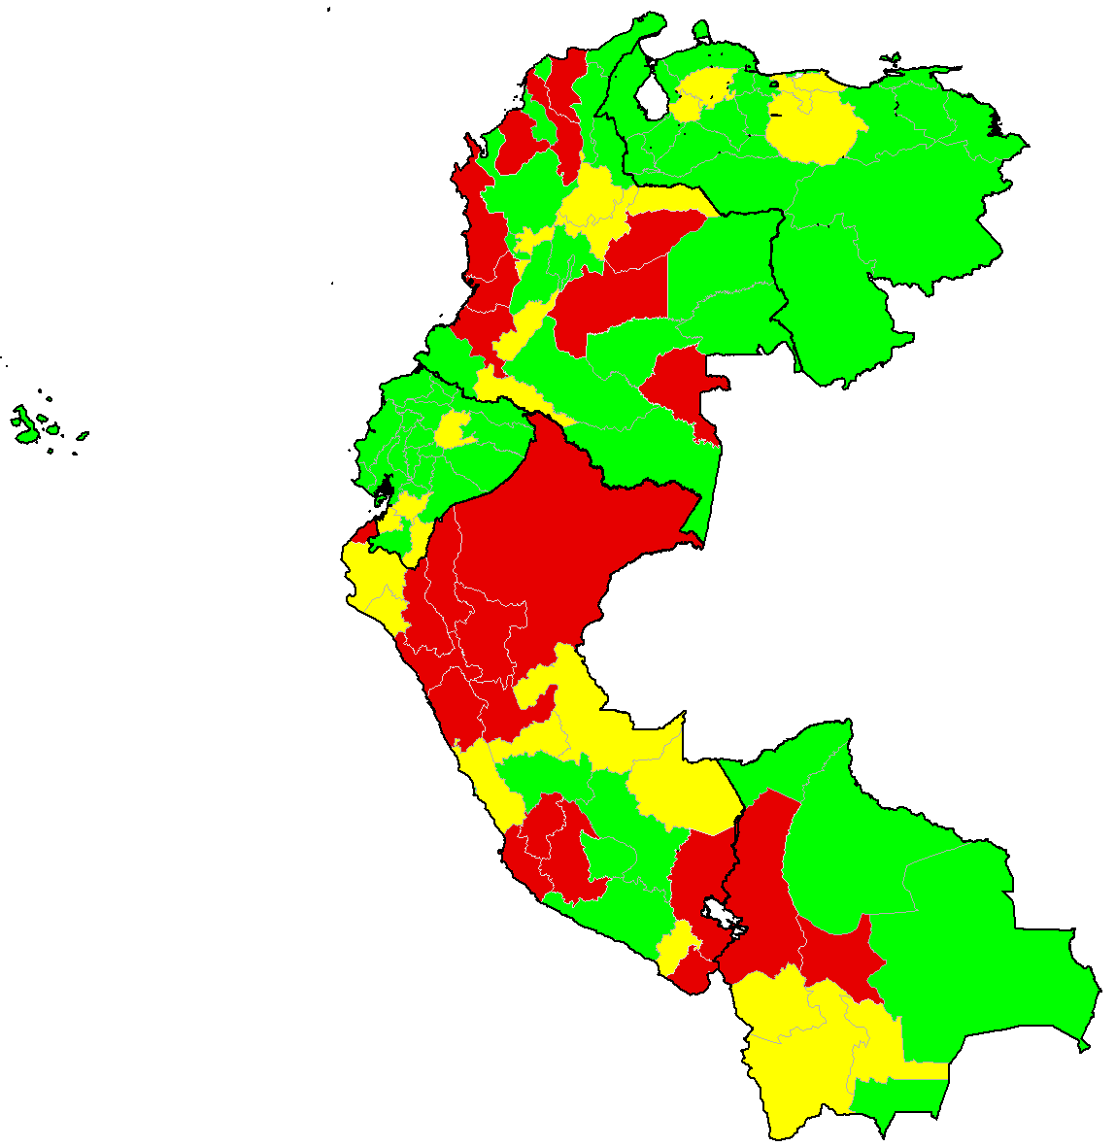
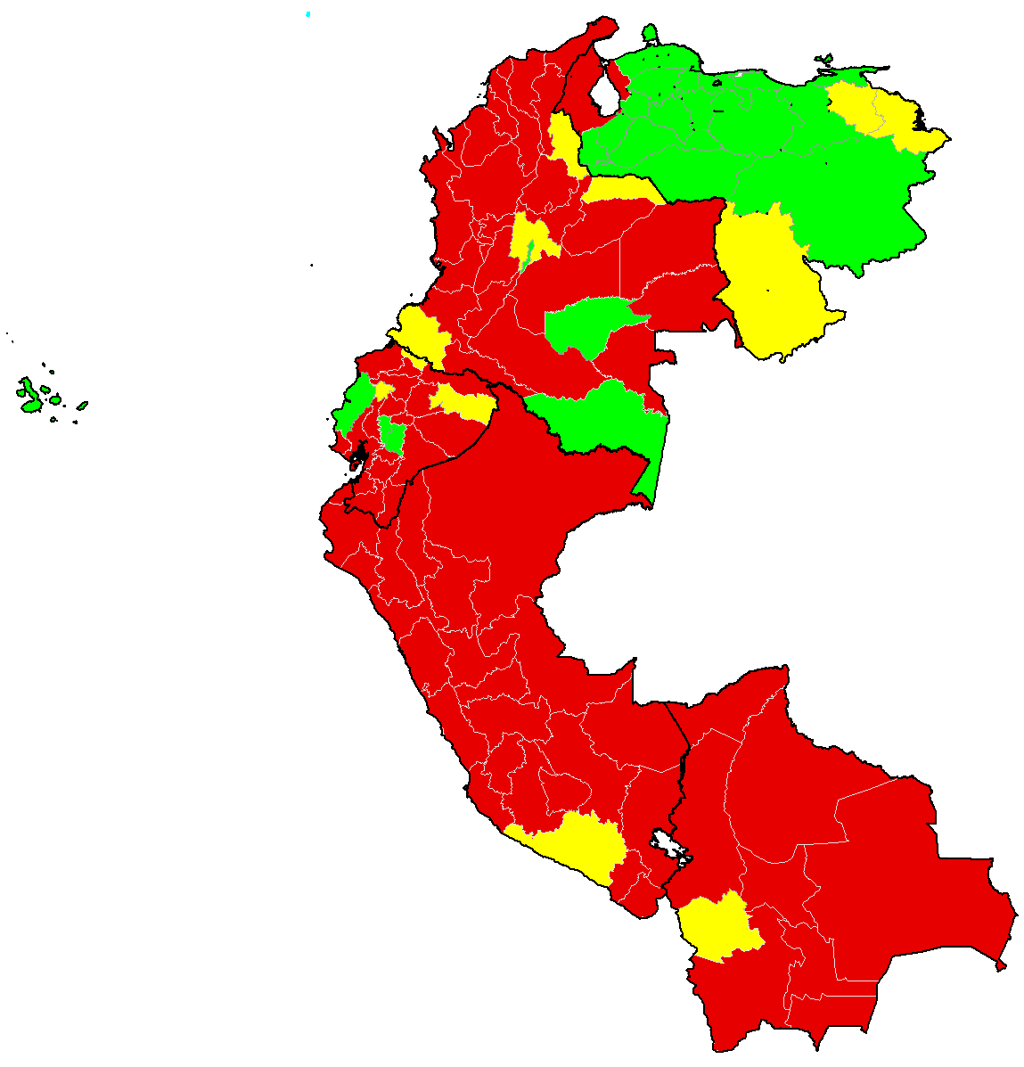
Rate of Suspected Measles/Rubella Cases per 100,000 population by subnational level, Andean Countries, 2019-2020*
N=7,346
N=1,849
2019
2020
Rate per 100,000 population
Proportion of subnational levels by notification rates and year
<1
1-1.99
≥2
Source: 1) ISIS for notification of measles and rubella suspected cases. 2) Country population estimates sent to PAHO in 2018 and 2019.
*Data as of 20 March 2021. **Subnational levels with less than 100,000 population and reporting at least 1 suspected case per year was colored green; if the subnational levels were epidemiologically silent, then it was colored red.

