Slide 1
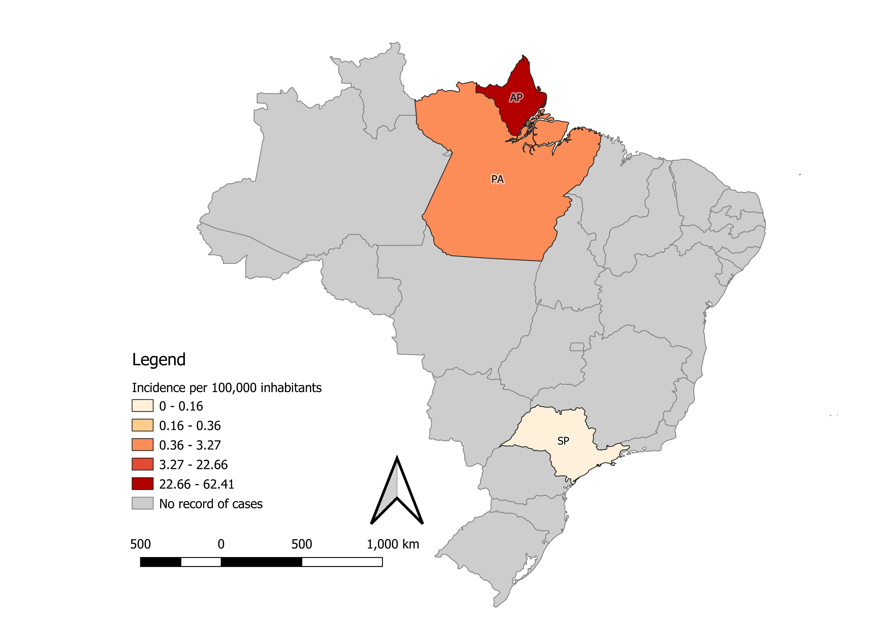
Measles outbreak in Brazil, 2021*
Distribution of confirmed measles cases by epidemiological weeks and subnational level
Distribution of measles incidence rate by subnational level
N=414
Most affected groups (with data available for 347 cases):
<1 year old: 55,74 per 100,000 population | 1-4years old: 11,95 per 100,000 population
Source: Ministry of Health of Brazil. *Data as of epidemiologival week 17, 2021

