Slide 1
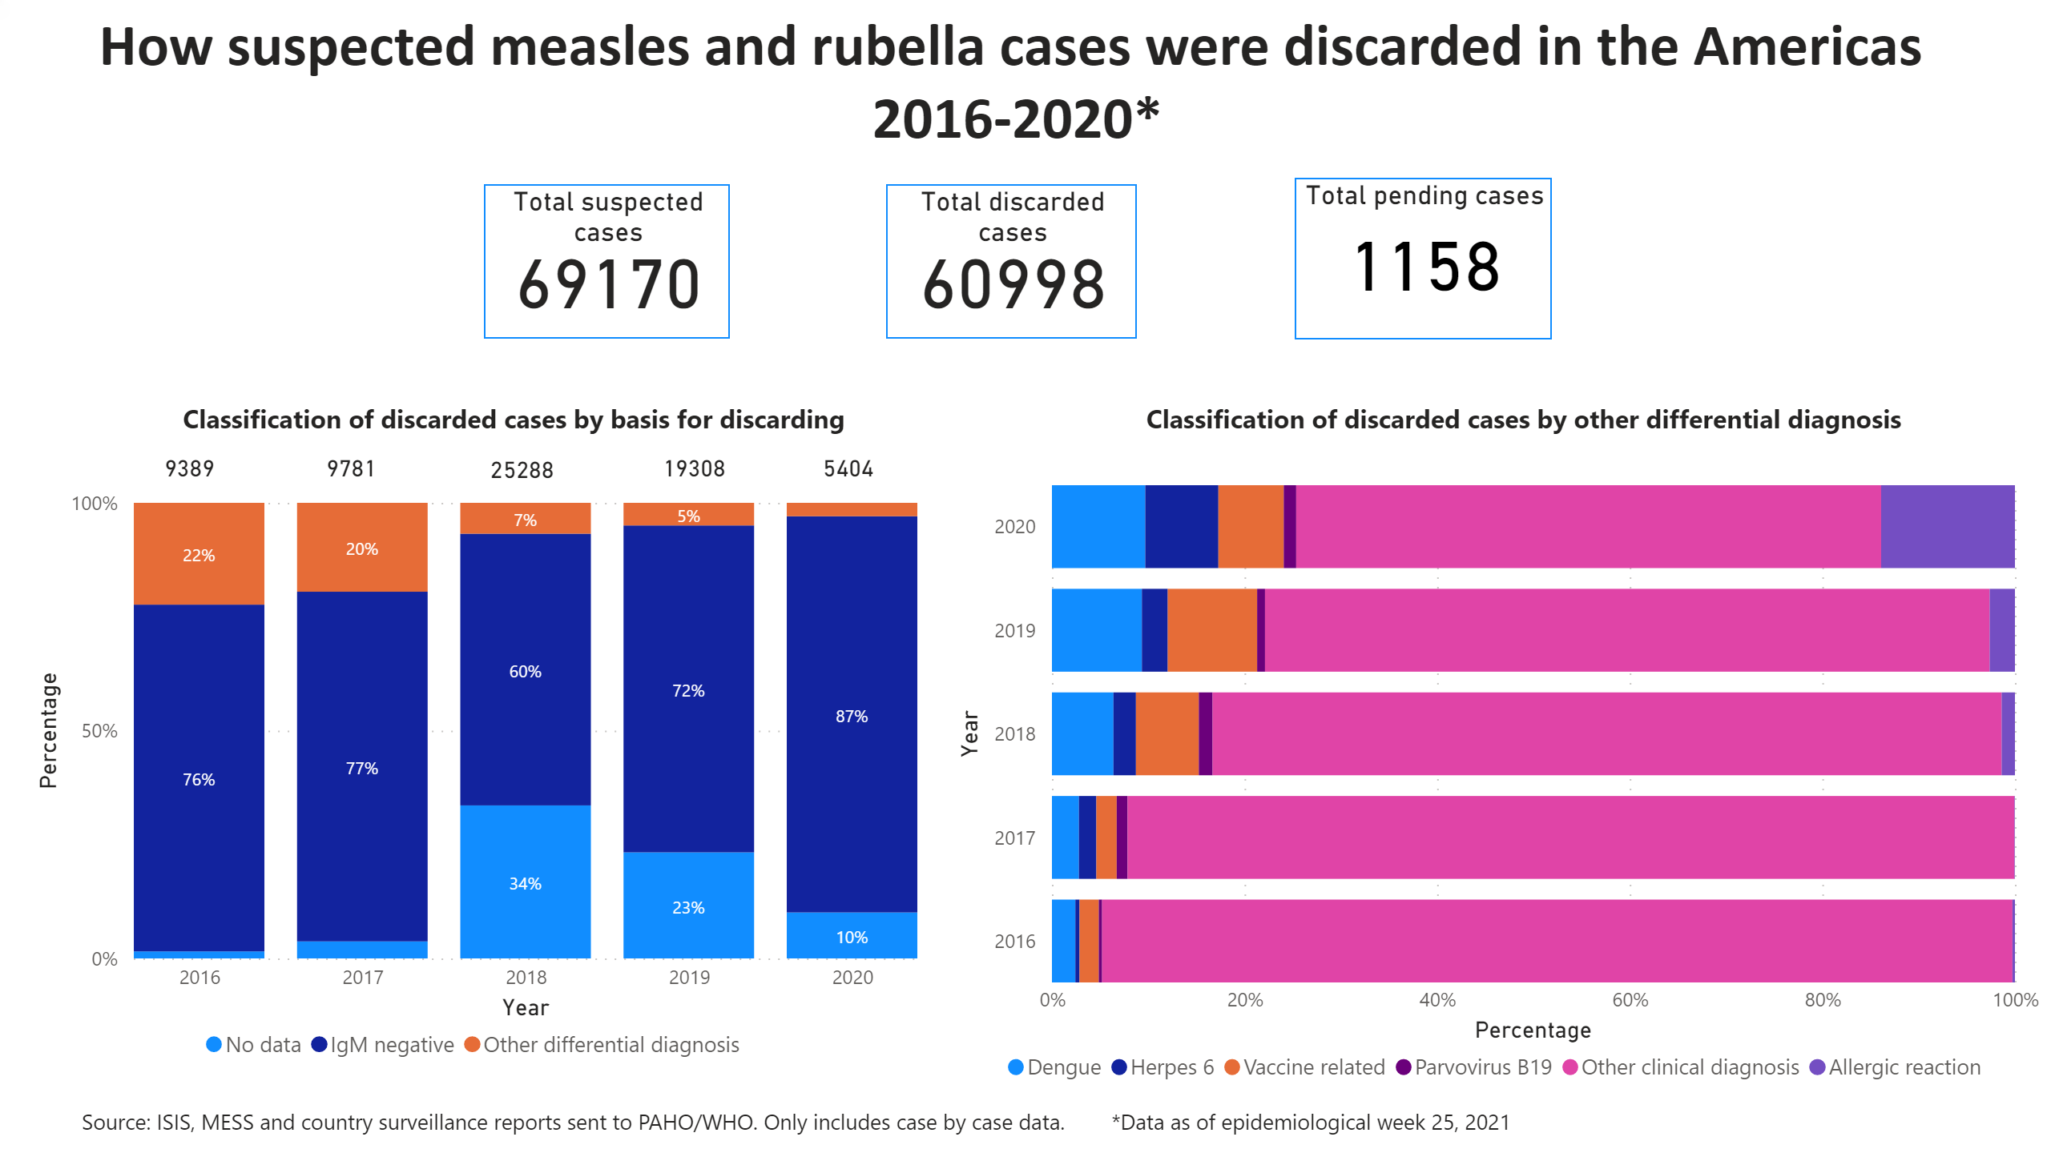
ENG_2016-2020
Notes:
textbox
No alt text provided.
textbox
No alt text provided.
textbox
No alt text provided.
textbox
No alt text provided.
textbox
No alt text provided.
Total suspected cases
No alt text provided.
N=
No alt text provided.
Total pending cases
No alt text provided.
N=
No alt text provided.
N=
No alt text provided.
hundredPercentStackedColumnChart
No alt text provided.
Total discarded cases
No alt text provided.
N=
No alt text provided.
N=
No alt text provided.
hundredPercentStackedBarChart
No alt text provided.

