Slide 1
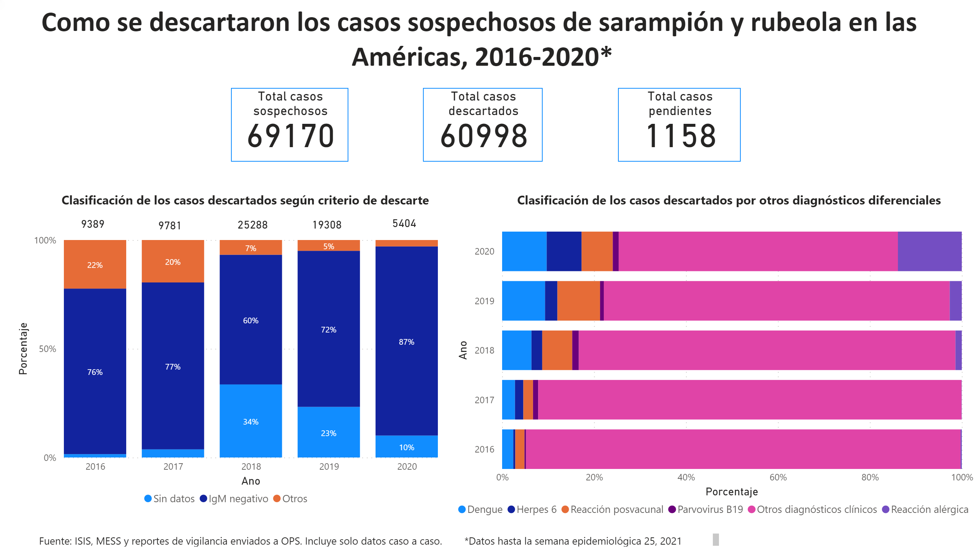
2016-2020
Notes:
textbox
No alt text provided.
Total casos sospechosos
No alt text provided.
Total casos descartados
No alt text provided.
Total casos pendientes
No alt text provided.
hundredPercentStackedColumnChart
No alt text provided.
hundredPercentStackedBarChart
No alt text provided.
textbox
No alt text provided.
textbox
No alt text provided.
textbox
No alt text provided.
textbox
No alt text provided.
card
No alt text provided.
card
No alt text provided.
card
No alt text provided.
card
No alt text provided.
card
No alt text provided.

