Slide 1
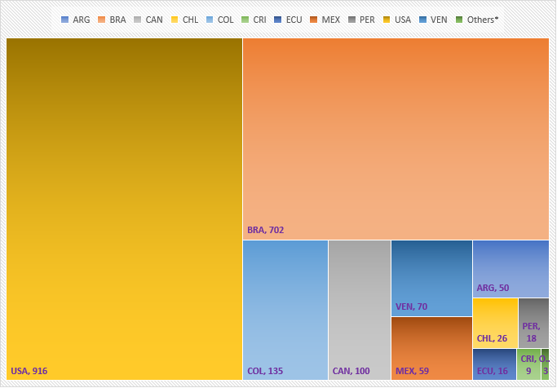
Measles sequences reported to MeaNS by country and genotype.
Region of the Americas, 2018-2020
A total of 2,106 measles sequences reported by 14 countries
D8 genotype: 1,970 sequences reported by 12 countries
B3 genotype: 134 sequences reported by 8 countries
Source: MeaNS, N-450 sequences by 30 June 2021. MeaNS: Measles Nucleotide Surveillance
Notes:
these are the measles virus sequences reported to MeaNS during the last years, only two genotypes have been detected during all this period, D8 and B3.

Slide 2

Secuencias de sarampión reportadas al MeaNS por país y genotipo. Las Américas, 2018-2020
Un total de 2,106 secuencias de sarampión reportadas por 14 países
Genotipo D8: 1,970 secuencias reportadas por 12 países
Genotipo B3 : 134 secuencias reportadas por 8 países
Fuente: MeaNS, N-450 secuencias reportadas al 30 de Junio de 2021. MeaNS: Measles Nucleotide Surveillance
Notes:
these are the measles virus sequences reported to MeaNS during the last years, only two genotypes have been detected during all this period, D8 and B3.

