Slide 1
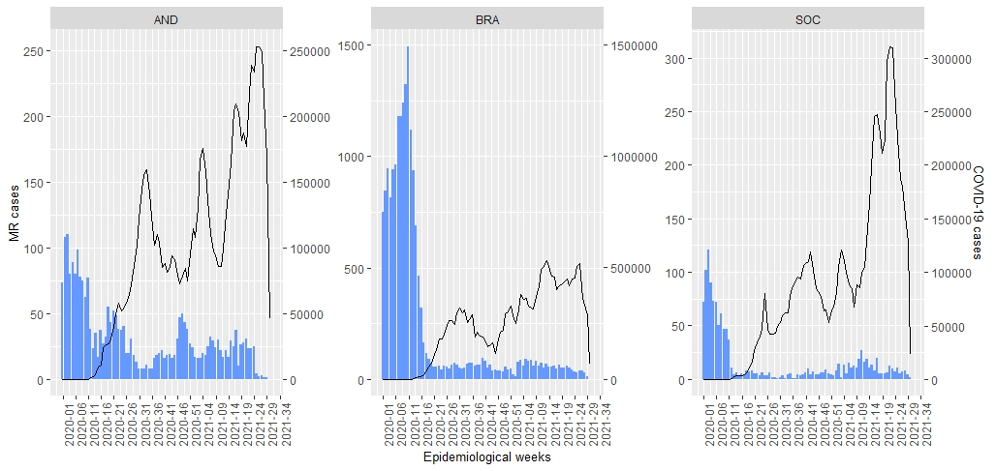
Notification of suspected measles and rubella (MR) cases and COVID-19 cases by epidemiological week, South America*, 2020-2021**
MR cases | COVID-19
22,862 | 34,521,980
*Andean (AND) = Bolivia, Colombia, Ecuador, Peru and Venezuela | Brazil (BRA) | Southern Cone (SOC) = Argentina, Chile, Paraguay and Uruguay
**Data as of epidemiological week 30, 2021. Source: Surveillance country reports sent to PAHO.

