Slide 1
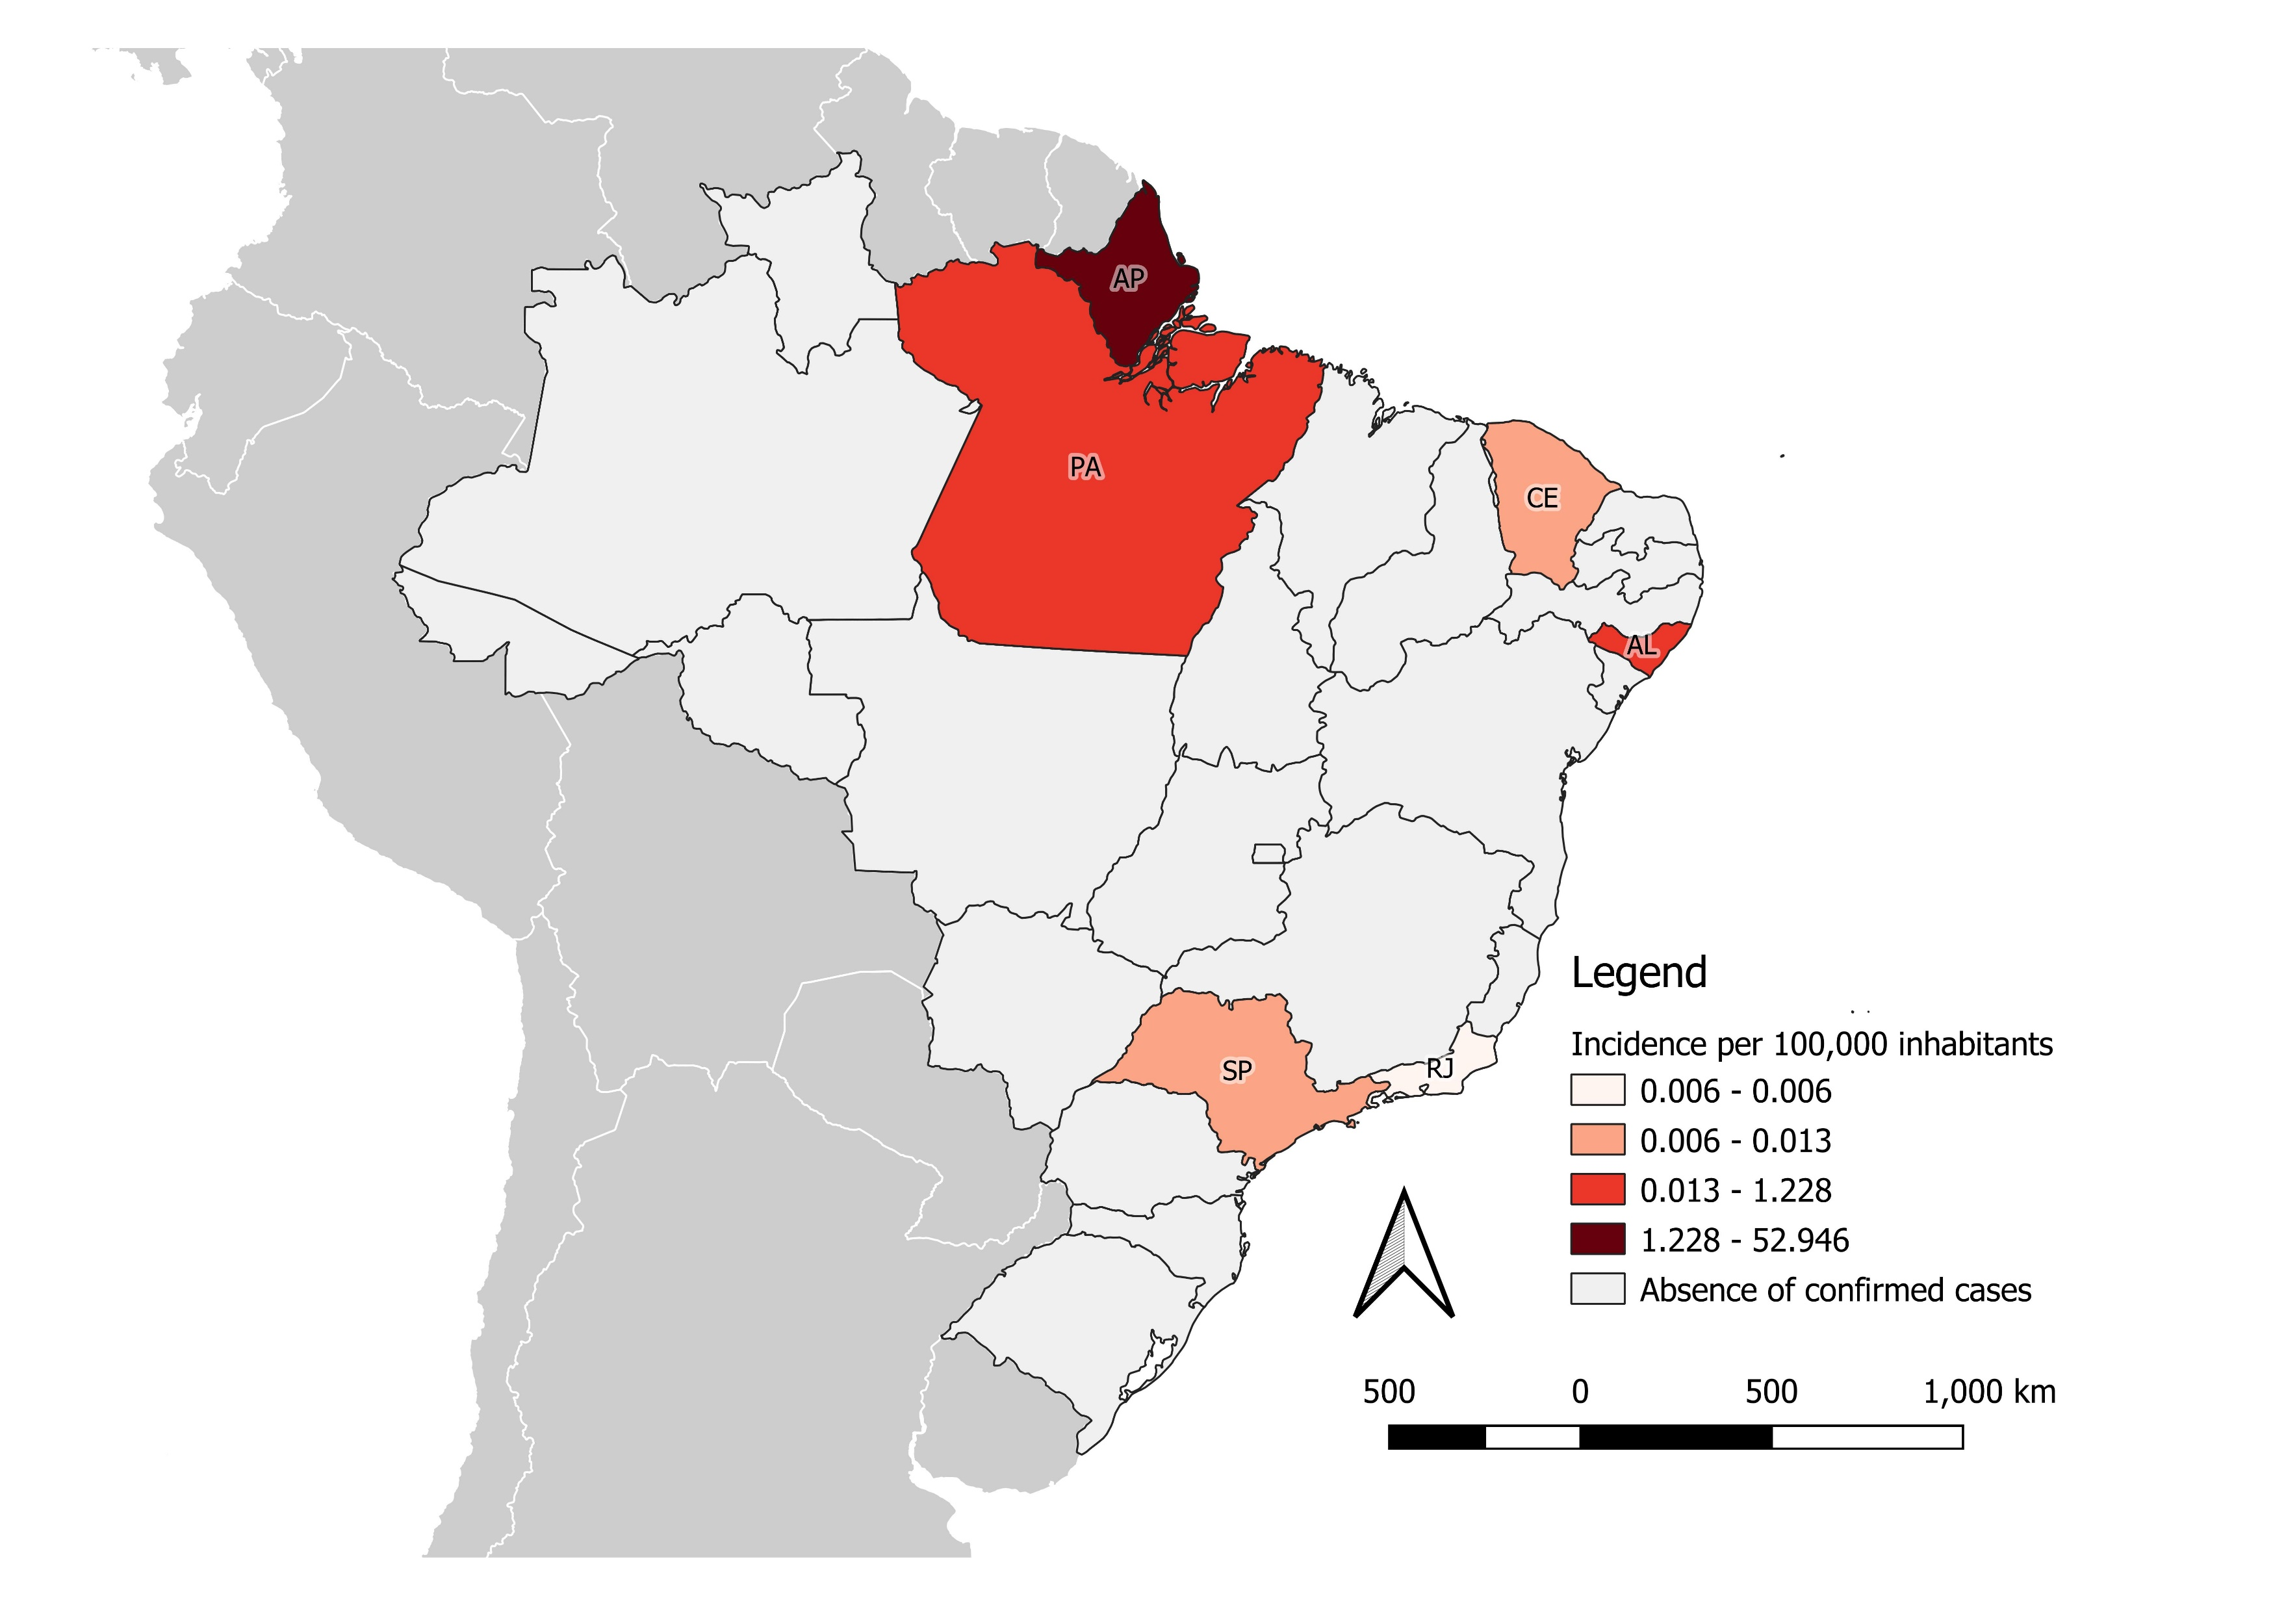
Measles hotspots in Brazil, 2021
Distribution of confirmed measles cases by epidemiological week and subnational level
Measles incidence rate per 100,000 population by subnational level
AWPC:* -7.52%
N=582
*AWPC: Average Weekly Percent Change indicator was used as part of the statistical regression model joint point of a time series analysis. AP (Amapá), PA (Pará) AL (Alagoas), SP (Sao Paolo), CE (Ceara), RJ (Rio de Janeiro)
Data as of epidemiological week 36, 2021 | Source: Boletim de Notificação Semanal (BNS-36/2021)
Notes:
Measles virus continues circulating in Brazil, amidst several vaccination actions among susceptible population. The state of Amapá concentrates the largest numbers of cases in 2021 (78%). Nevertheless, there is a decreased in the notification of confirmed cases, with an average weekly percent reduction of -7.52%, due to the intensification of vaccination and improving of surveillance quality. Outbreaks are still active in the states of Amapá, Pará, and Alagoas.

