Slide 1
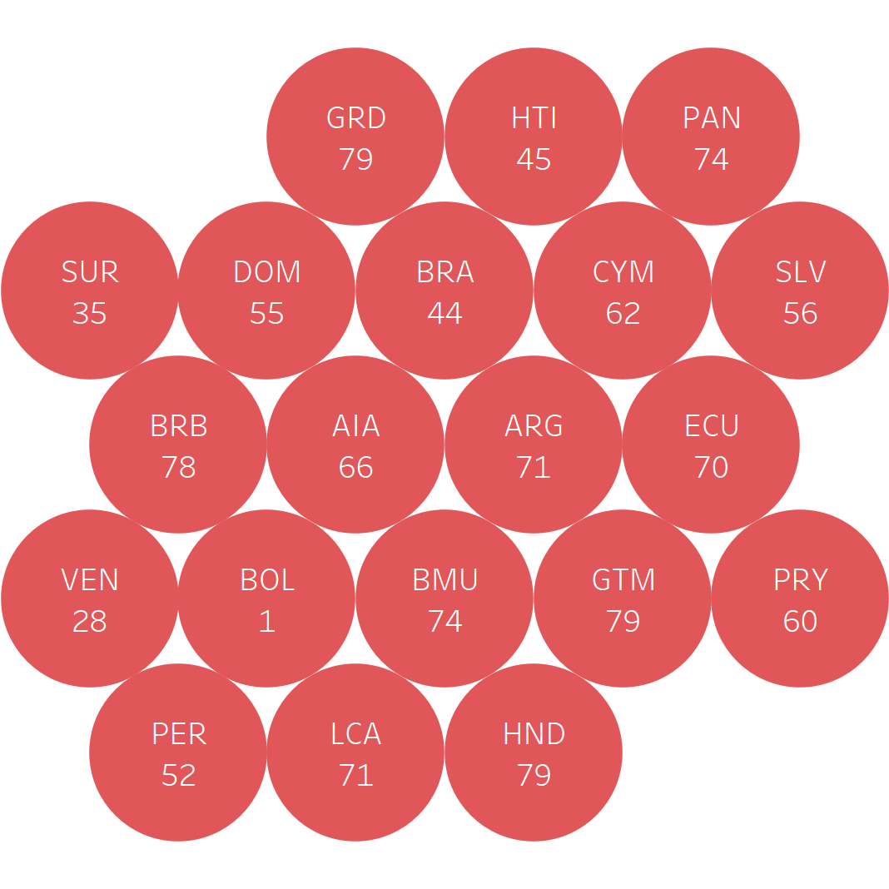
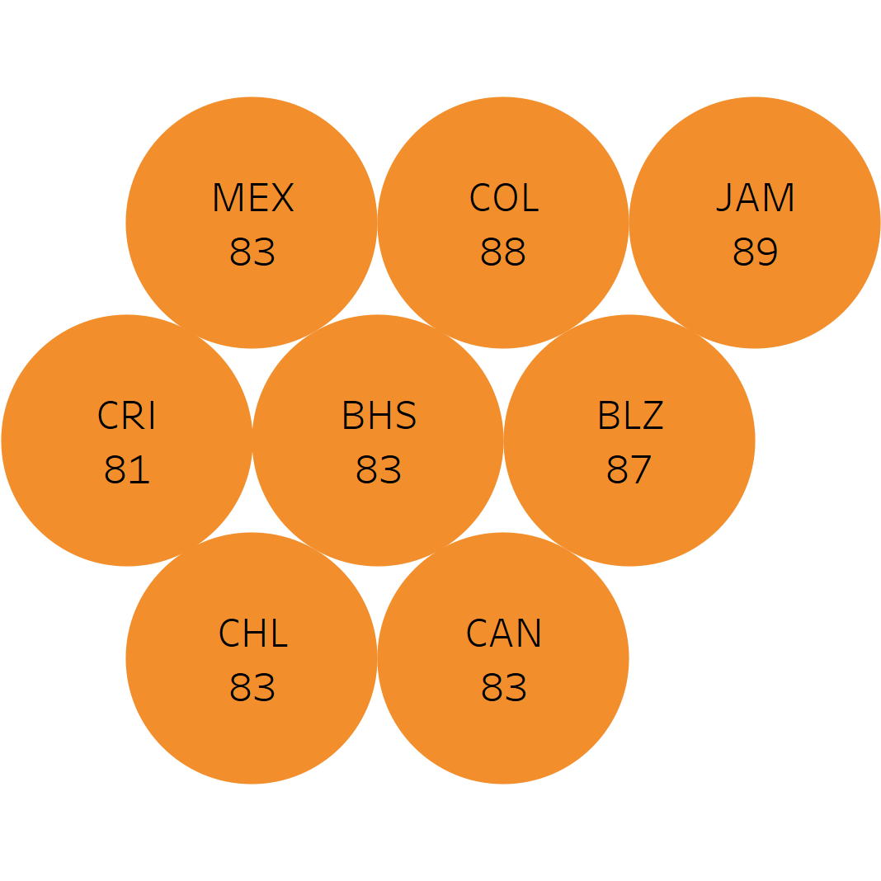
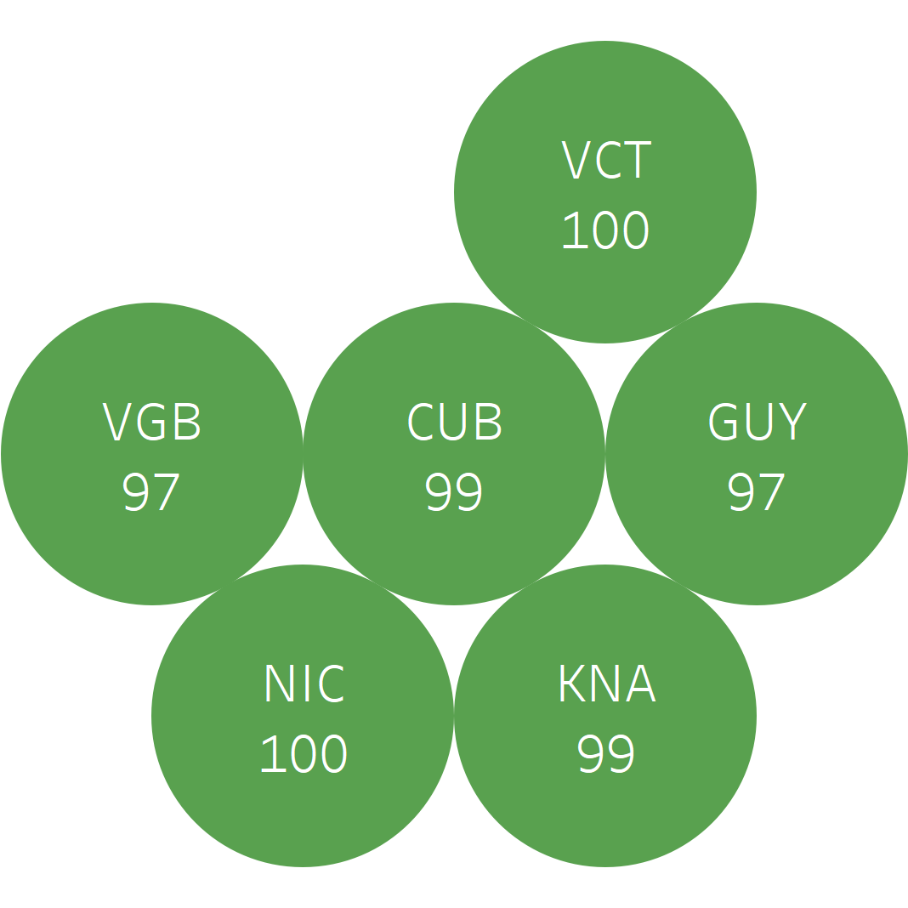
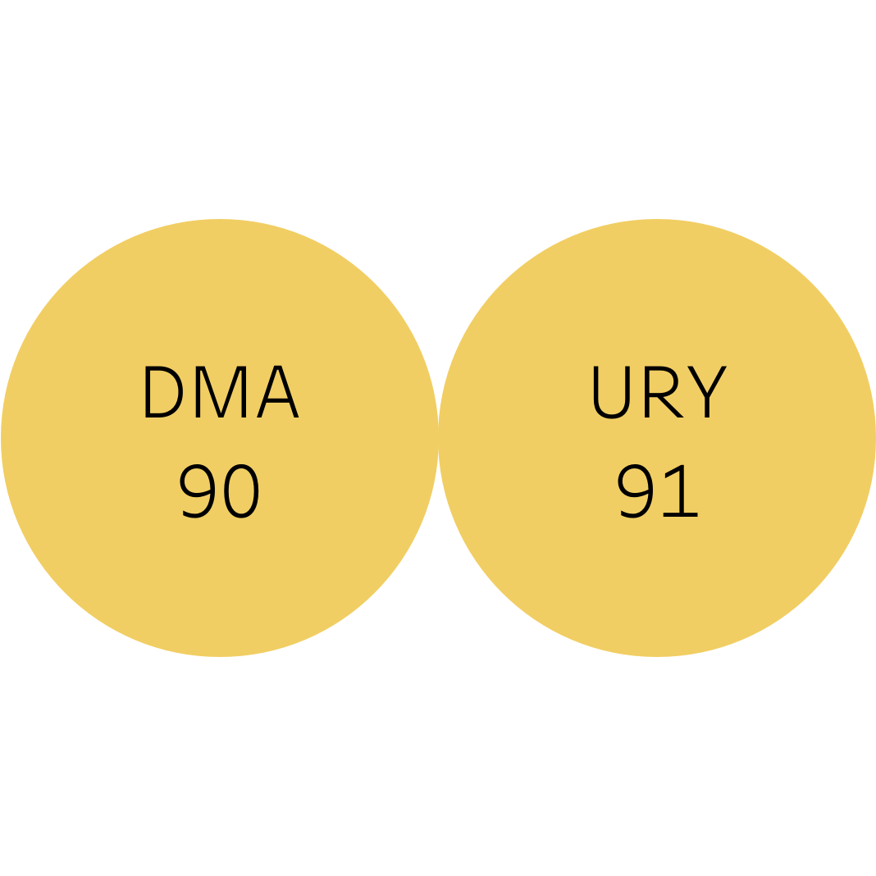
Distribution of countries by MMR2 vaccination coverage range Region of the Americas, 2020
Coverage (%)
<80%
80-89%
90-94%
>=95%
Coverage range
Source: Country reports through the PAHO-WHO/UNICEF electronic Joint Reporting Form (eJRF), 2021.
MMR-measles-mumps-rubella

