Slide 1
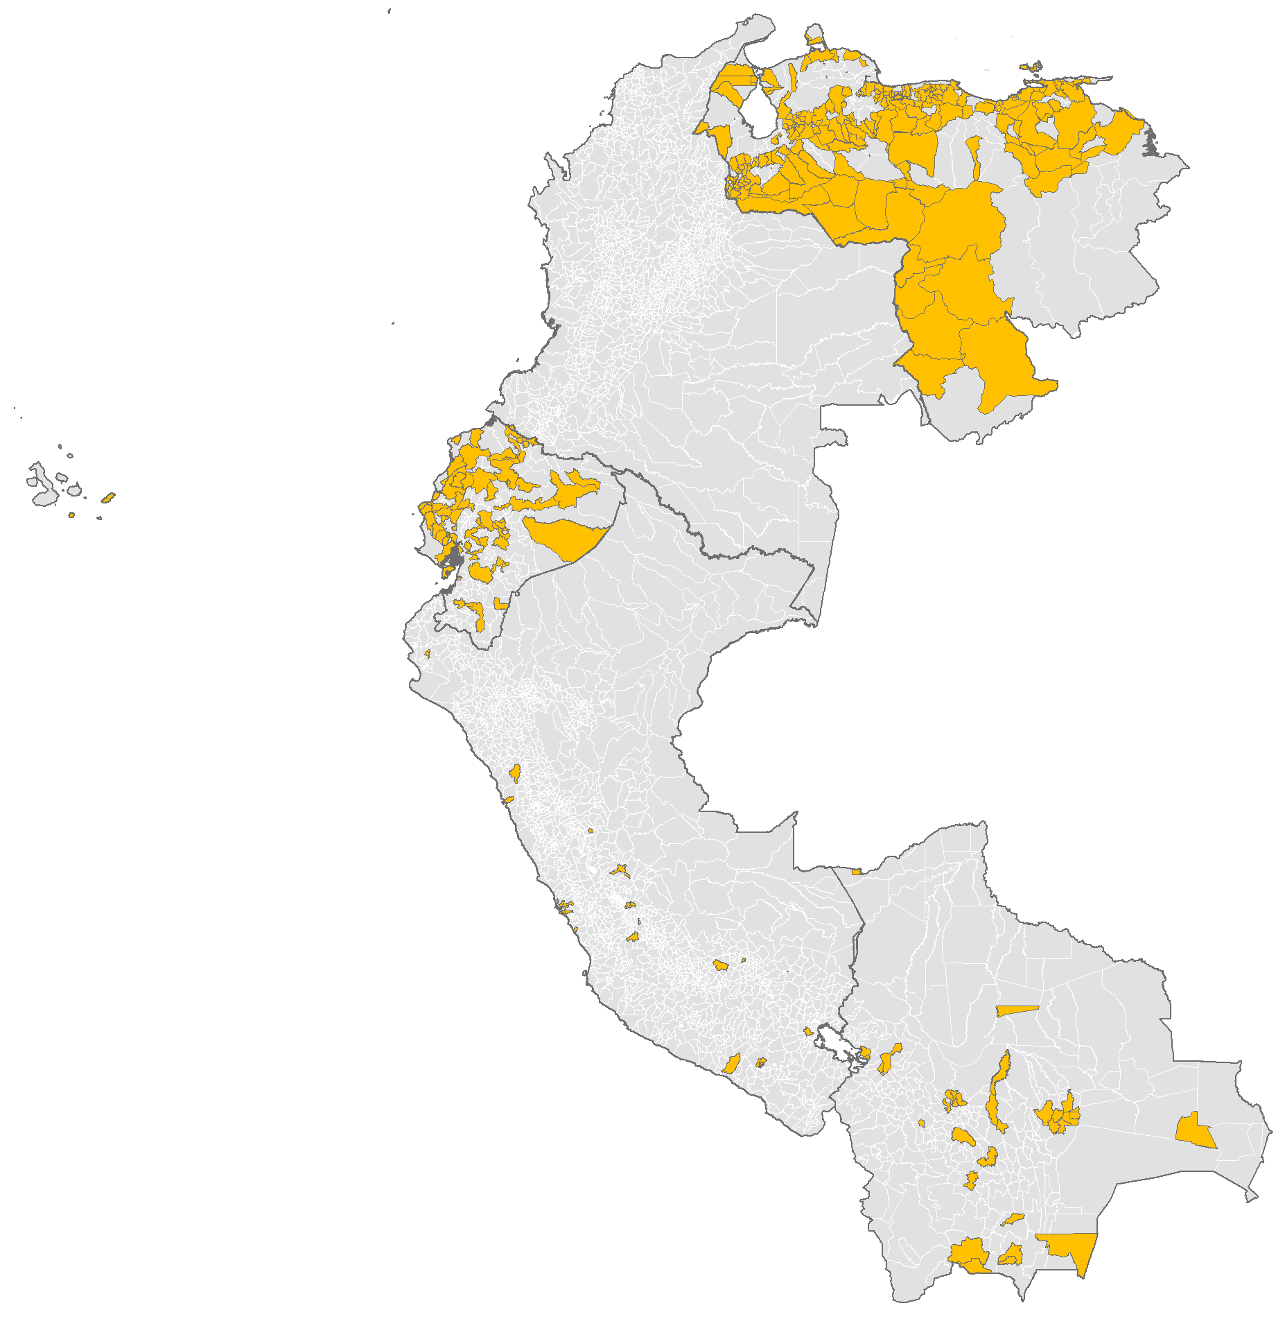
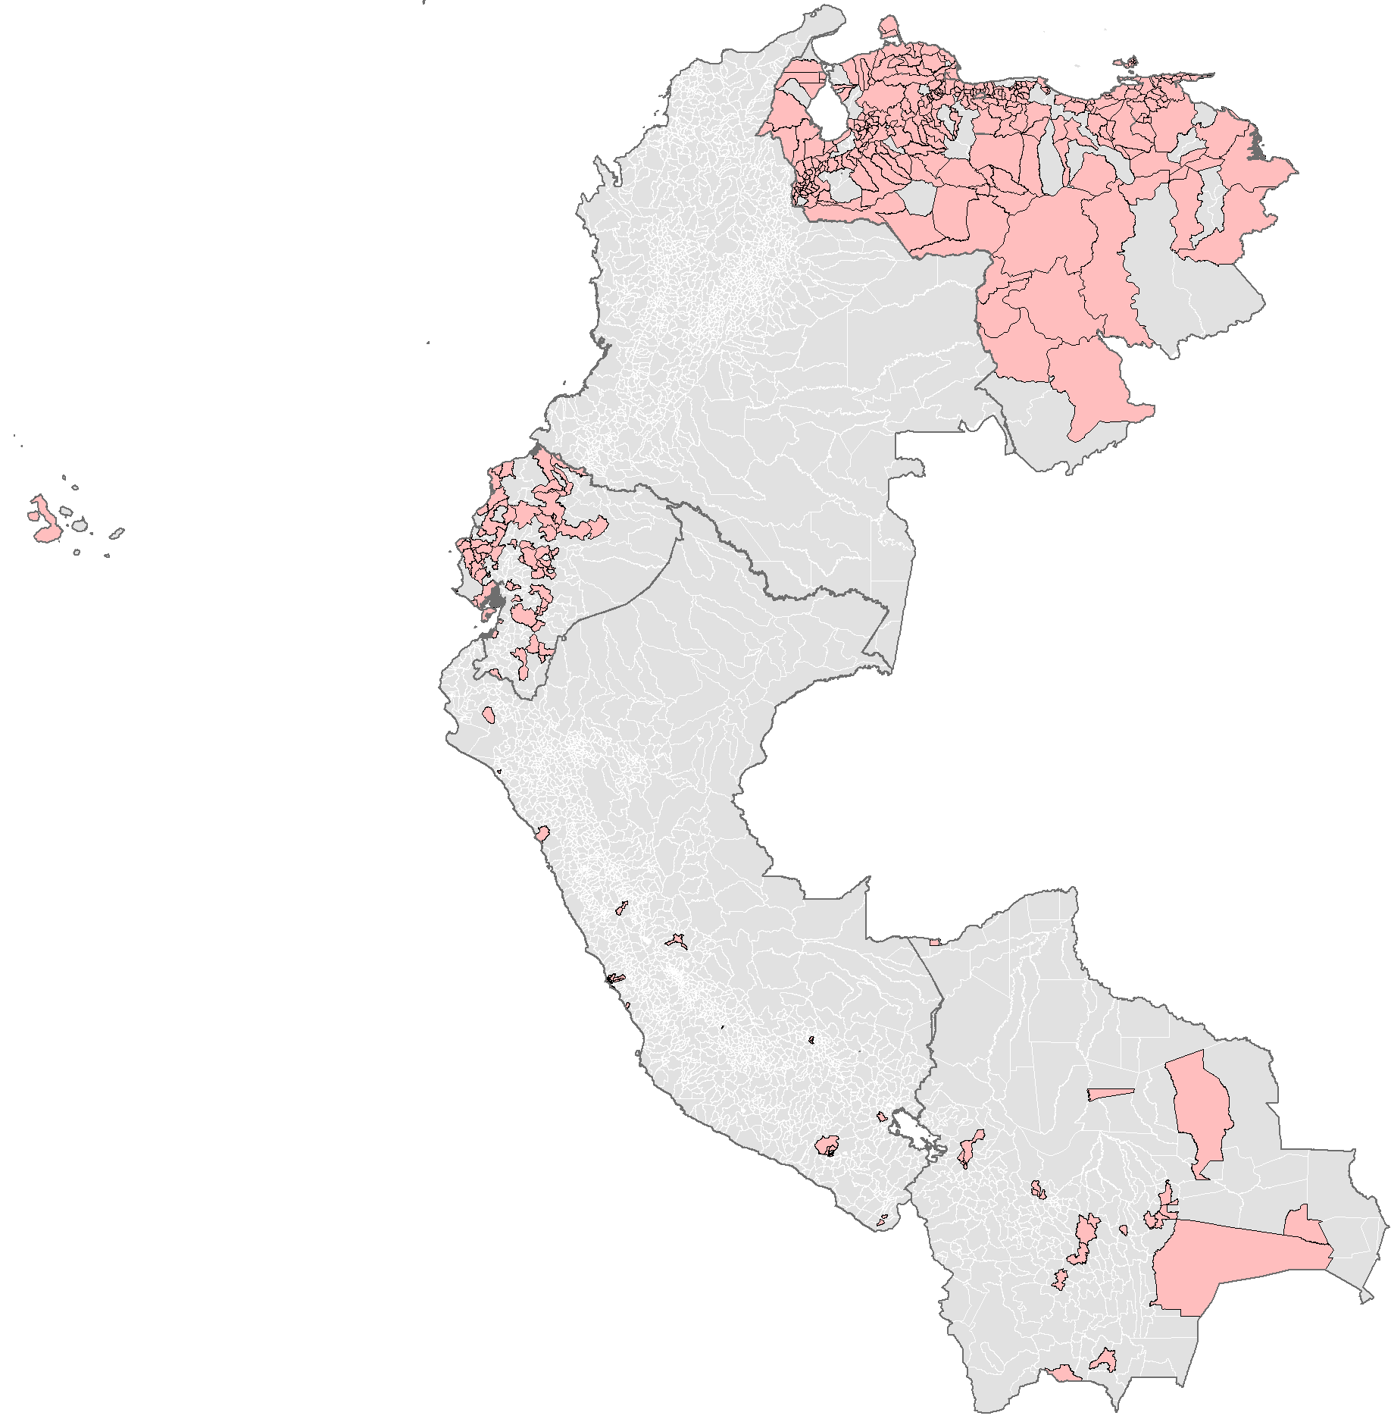
Municipalities* reporting suspected cases of measles and rubella
Andean Region countries, 2020-2021**
In 2020 and 2021, 87% and 85% of municipalities did not report suspected cases. This high proportion of silent municipalities is mainly due to the COVID-19 pandemic.
 | Total number of municipalities |  | Number of municipalities with cases
Country | 2020 | 2021 | 2020 | 2021
Bolivia | 340 | 339 | 33 | 24
Colombia | 1122 | 1122 | 114 | 170
Ecuador | 221 | 221 | 64 | 61
Peru | 1874 | 1874 | 40 | 38
Venezuela | 335 | 335 | 220 | 291
TOTAL | 3892 | 3891 | 471 | 584
2020
N=471
(12%)
2021
N=584
(15%)
* Some municipalities did not match the geocode used to develop this map.
**Data as of 12 August 2022.
Source: Integrated Surveillance Information System (ISIS)

