Slide 1
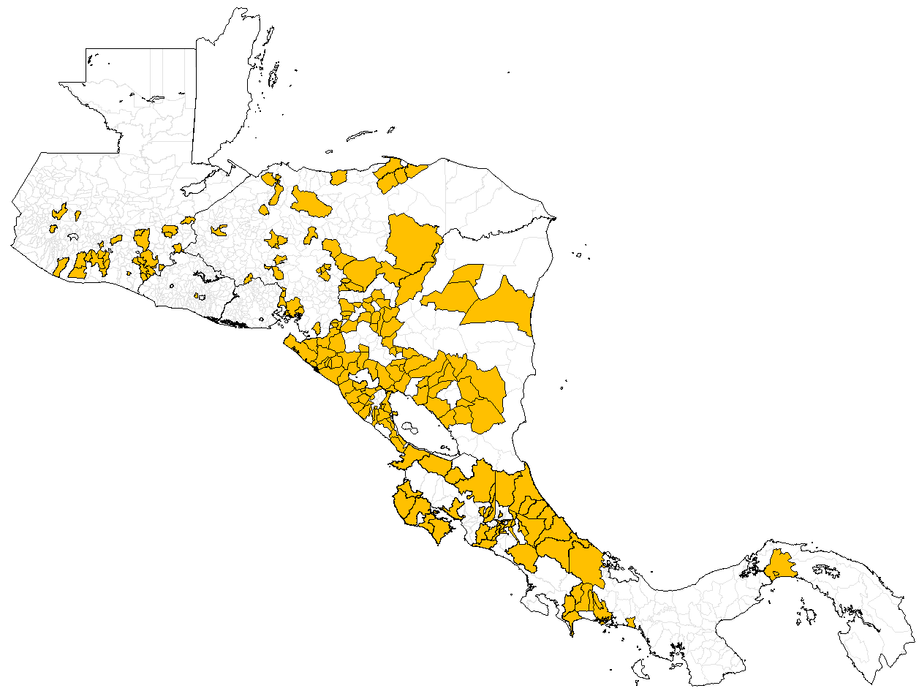
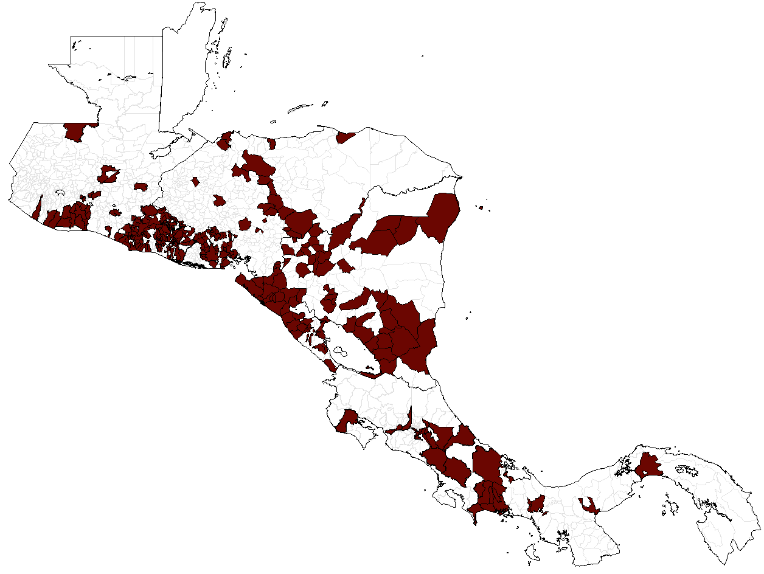
Municipalities* reporting suspected cases of measles and rubella
Central America countries, 2020-2021**
2020
N=225
(19%)
2021
N=366
(30%)
 | Number of municipalities |  | Number of municipalities with cases
Country | 2020 | 2021 | 2020 | 2021
Costa Rica | 81 | 81 | 37 | 14
El Salvador | 262 | 262 | 1 | 184
Guatemala | 340 | 340 | 53 | 49
Honduras | 298 | 298 | 37 | 24
Nicaragua | 153 | 153 | 86 | 80
Panama | 81 | 81 | 11 | 15
TOTAL | 1215 | 1215 | 225 | 366
In 2020 and 2021, 81% and 70% of municipalities did not report suspected cases. This high proportion of silent municipalities is mainly due to the COVID-19 pandemic.
* Some municipalities did not match the geocode used to develop this map.
**Data as of 12 August 2022.
Source: Integrated Surveillance Information System (ISIS)

