Slide 1
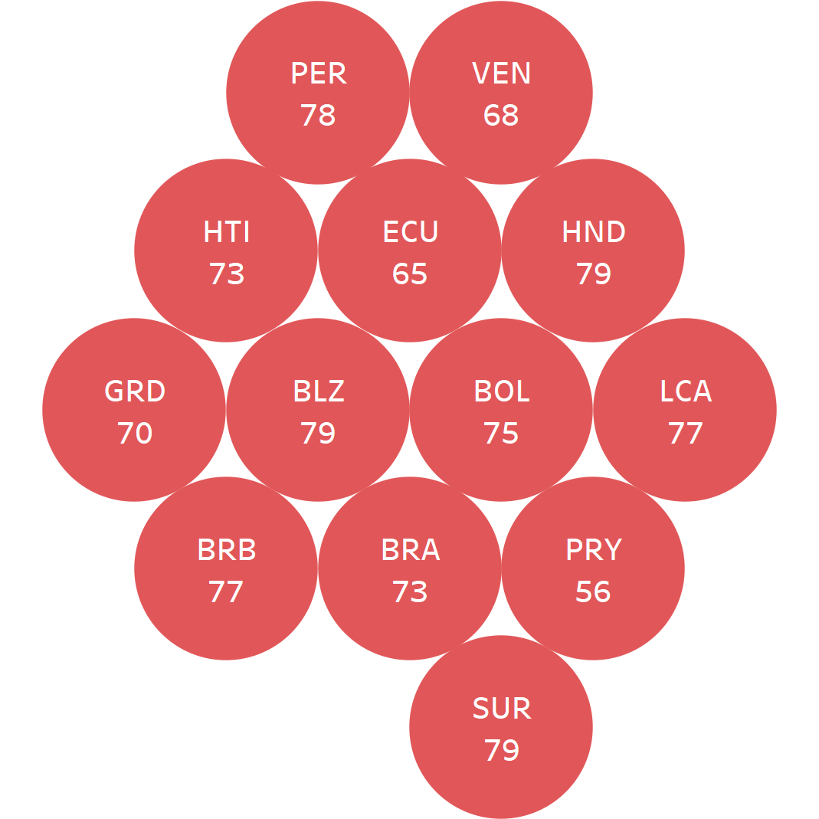
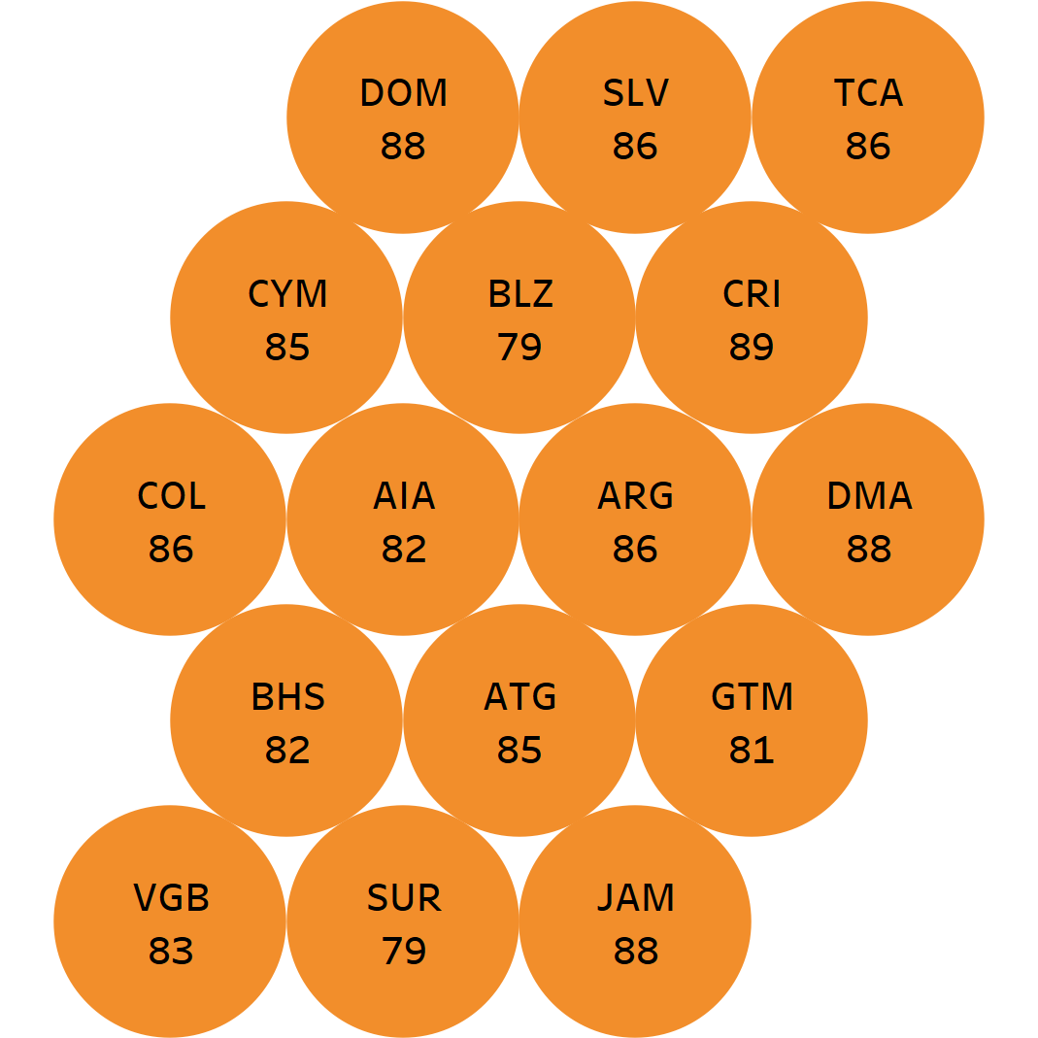
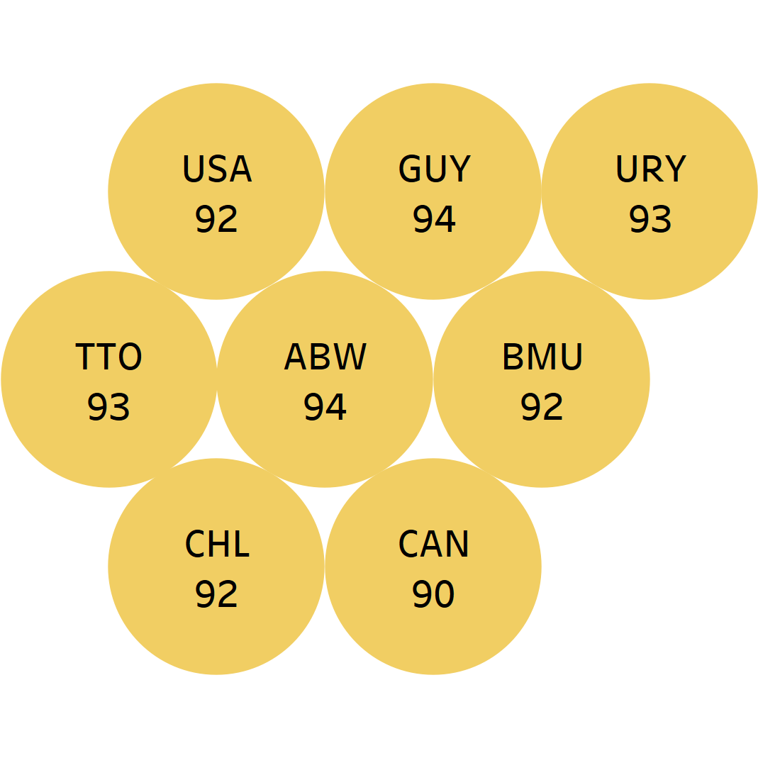
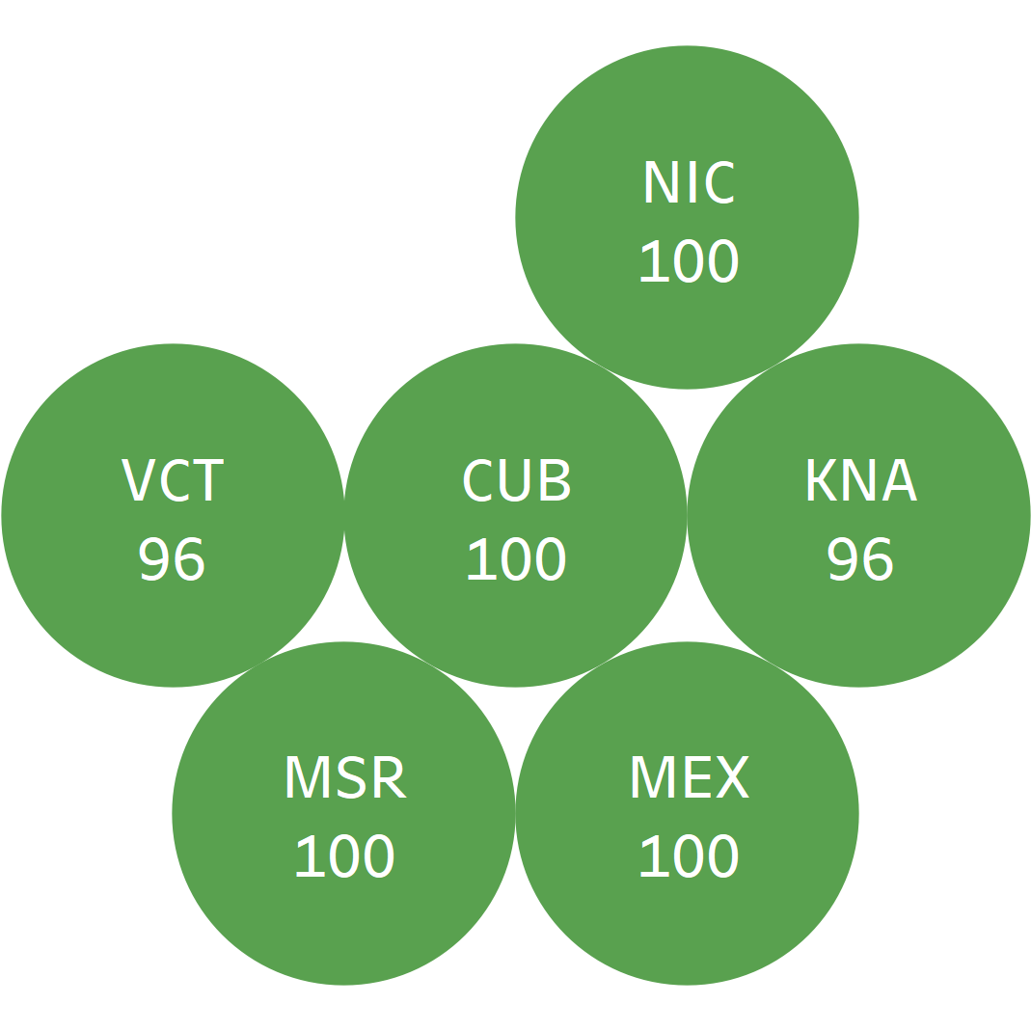
Distribution of countries by MMR1 vaccination coverage range Region of the Americas, 2021
<80%
80-89%
90-94%
>=95%
Coverage ranges
Source: Country reports through the PAHO-WHO/UNICEF electronic Joint Reporting Form (eJRF), 2022.
MMR-measles-mumps-rubella

