Slide 1
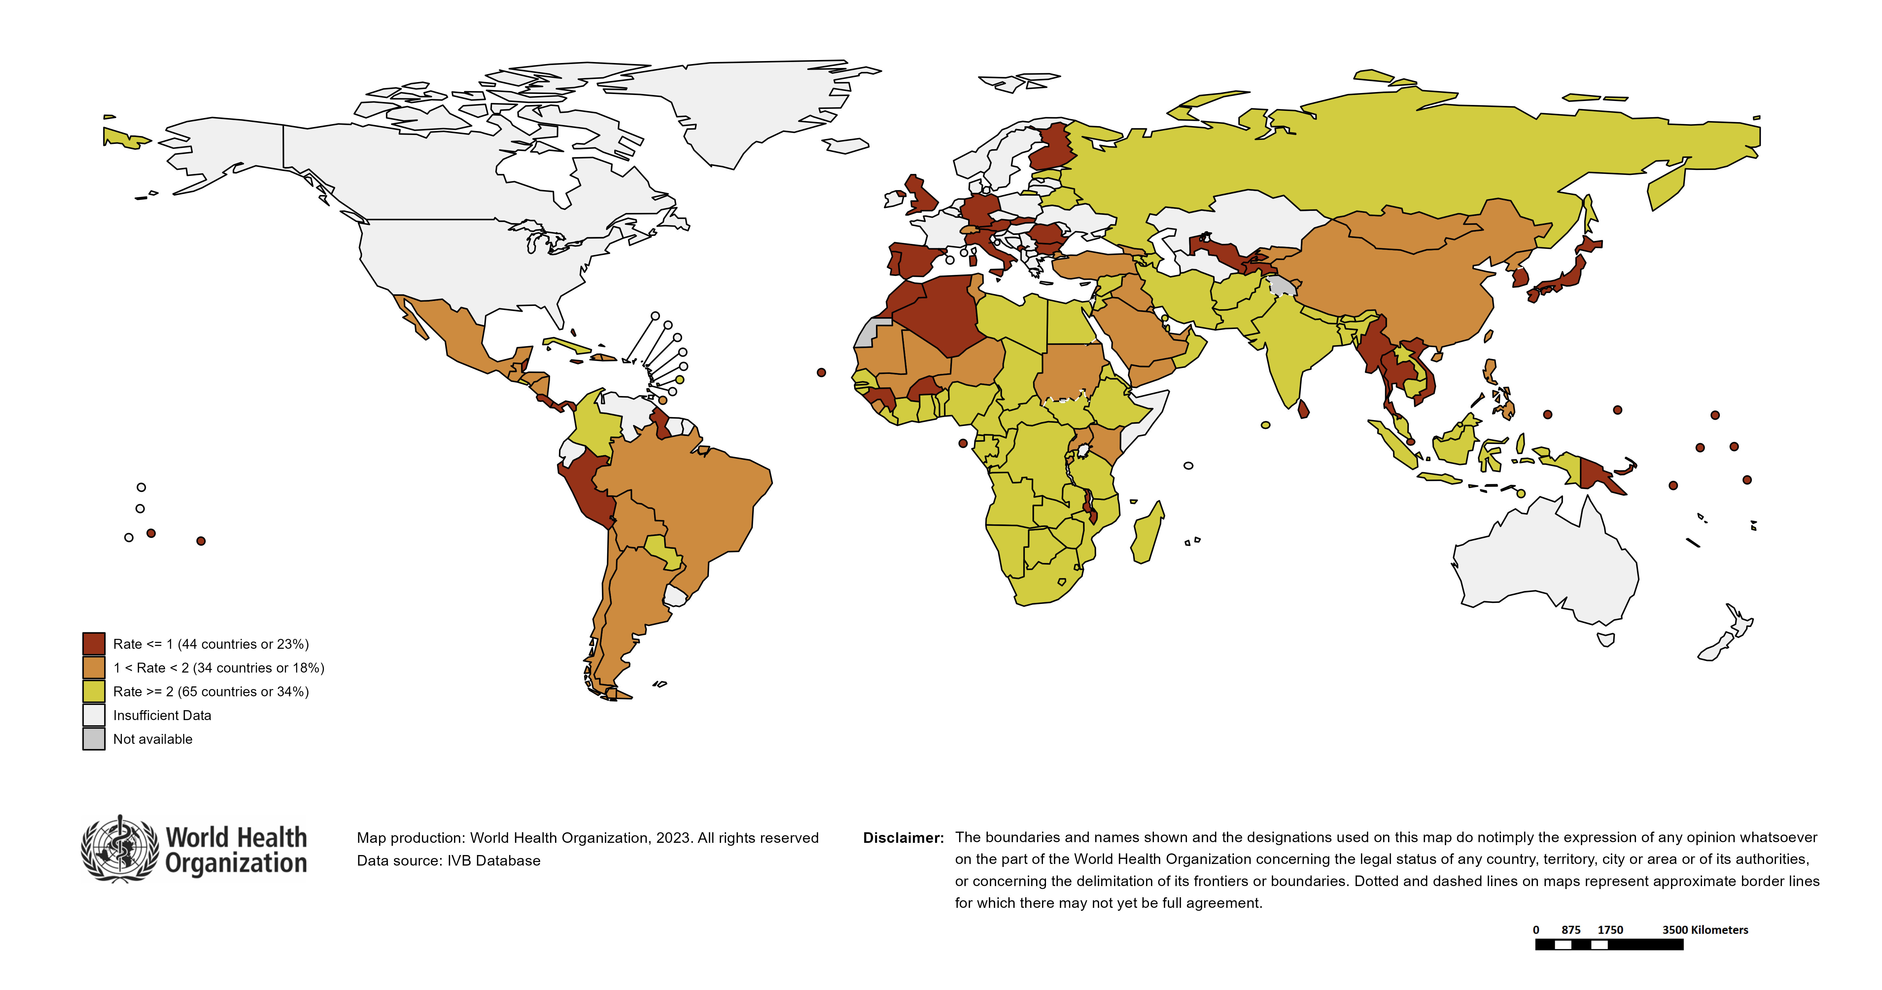
Surveillance sensitivity reporting rate of suspected* measles and rubella cases (last 12 months) at the global level
Notes: Based on data received 2023-05 - Surveillance data from 2022-04 to 2023-03 - Target: >= 2 discarded cases* / 100,000 population** - * Suspected cases investigated and discarded as non-measles non-rubella using laboratory testing and/or epidemiological linkage to another etiology ** World population prospects, 2019 revision

