Slide 1
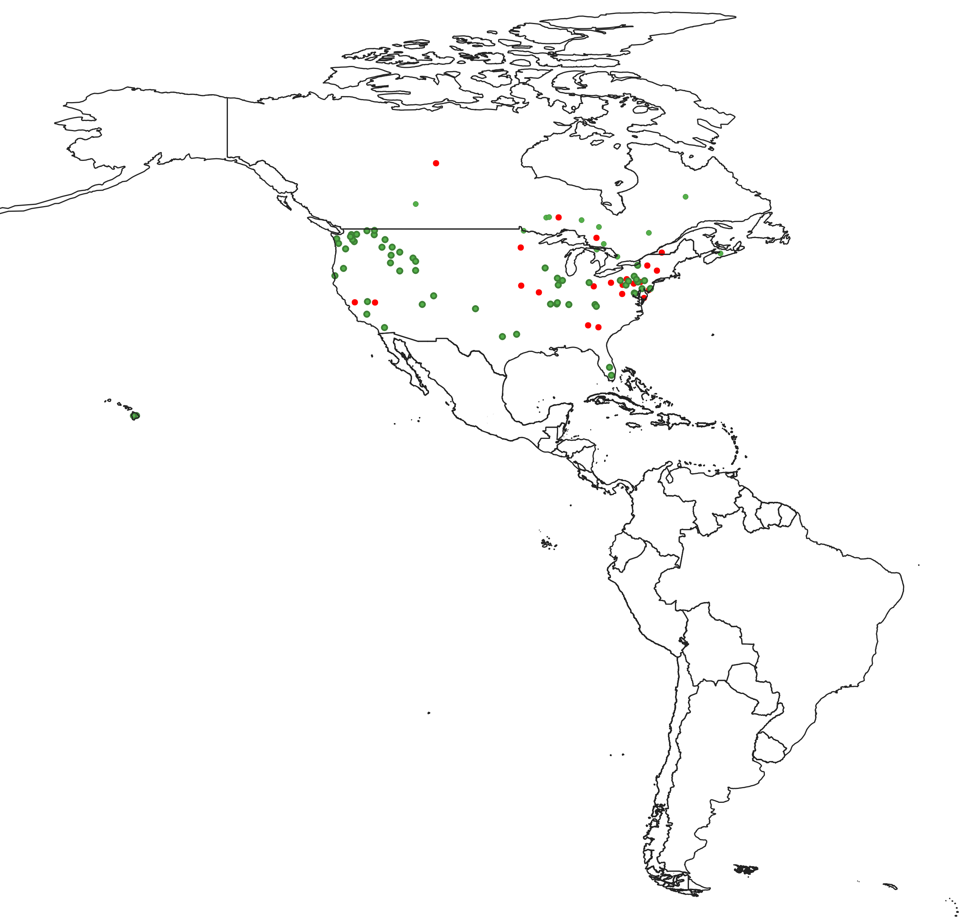
Distribution of Confirmed Measles Cases
Region of the Americas, 2023-2024*
2023
●
Canada=12
Chile=1
Costa Rica=1
USA=58
TOTAL=72
2024
1 dot = 1 confirmed case
●
Argentina= 2
Brazil^{A}=1
Canada=4
Peru=2
USA^{B}=18
TOTAL=27
Source: Integrated Information System (ISIS) and country reports to CIM/PAHO;
(A) Epidemiological Alert: Measles in the Region of the Americas, 29 January 2024, PAHO;
(B) Centers for Disease Control and Prevention (CDC) webpage at:
https://www.cdc.gov/measles/cases-outbreaks.html.
* Data up to 10 February 2024 (EW 06-2024)

