Slide 1
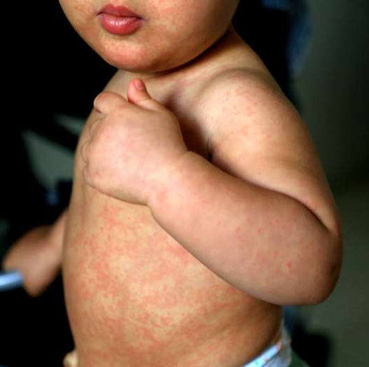
Where to find the recordings and presentations of the Measles Webinar
More than 2,000 participants connected to the webinar on the reemergence of measles organized by the Comprehensive Immunization Program, Pan American Health Organization. During the webinar the main aspects on measles clinical manifestations and its differential diagnosis, particularly with dengue were reviewed. In addition, the main actions to be implemented to increase surveillance sensitivity and immunity levels.
The recording and presentations of the webinar are available at the below link, which it can be used for advocacy and training activities in each country.
Link:
https://www.paho.org/en/events/webinar-measles-reemergence-update-clinical-surveillance-and-vaccination

