Slide 1
Identifying an outbreak and investigation steps

Slide 2
Objective
Present and recognize the steps in an outbreak investigation

Slide 3
Content
Common terms used in outbreak investigations
Responses and objectives of an outbreak investigation
Steps in an outbreak investigation
Example

Slide 4
Terms commonly used in outbreak investigations¹
Alert
The initial notification that a public health event with negative consequences is or may be taking place
Outbreak
An epidemic limited to a localized increase in incidence of disease
Detection
A finding made through a search using systematic methods
¹ World Health Organization. Rapid Risk Assessment of Acute Public Health Events. Geneva: WHO; 2015. Available from: https://apps.who.int/iris/bitstream/handle/10665/70810/WHO_HSE_GAR_ARO_2012.1_eng.pdf;sequence=1

Slide 5
Outbreak
The number of cases of disease or health condition is greater than expected at a given time and place
Sometimes there is no minimum number of cases: a single case of smallpox, measles, polio, or high pathogenic avian influenza is considered an outbreak
Outbreaks are not only infectious diseases. They can also include poisoning, accidents, violence, etc. when it relates to human health

Slide 6
Sources of information
Monitoring system
Laboratory
Healthcare staff
Media
Other

Slide 7
Responses and objectives of an outbreak investigation
Three responses to an outbreak:
1
Break the chain of transmission to prevent new cases. Usually this is the first priority.
2
Optimize case management, if the disease is treatable and the cost of treatment is reasonable.
3
Prevent future outbreaks.

Slide 8
Investigation objectives based on outbreak response
To implement this
RESPONSE:
The investigation needs the following main OBJECTIVES:
Optimize case management
Determine the etiologic agent involved
Break the chain of transmission
Determine the possible source
Prevent future outbreaks
Determine the mechanism for transmission

Slide 9
Steps in an outbreak investigation
1
2
3
4
Establish that an epidemic outbreak has taken place
Verify the diagnosis
Define and identify cases
Apply descriptive epidemiology
Determine who is at risk of falling ill
Develop a hypothesis
Evaluate the hypothesis
Reevaluate and refine the hypothesis / Conduct additional studies
Implement control and prevention measures
Prepare a written report and communicate the findings
8
7
6
5
9
10
Reingold AL. Outbreak Investigations—A Perspective. Emerg Infect Dis. 1998;4(1):21–27. Available from:
https://wwwnc.cdc.gov/eid/article/4/1/98-0104_article
David Heymann, Editor. Control of Communicable Diseases. Twelfth Edition. American Association of Public Health. 2015.

Slide 10
1
STEP
Is there an outbreak?
To determine whether observed cases are greater than what is expected, we need monitoring at the local level
– This can be demonstrated through a graph of case numbers represented in time, a map of the geographical scope, or both.
Large-scale outbreaks are self evident, while smaller outbreaks are more difficult to detect and confirm
It is more difficult to detect an outbreak in the early stages
The investigation may continue even if it is determined that there is no outbreak

Slide 11
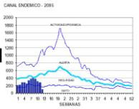
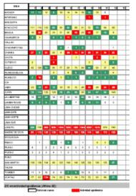
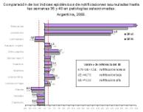
1
STEP
Is there an outbreak? (cont.)
Edemic channel graph model
Endemic channel linear model
Epidemic
rates

Slide 12
2
STEP
Verify the diagnosis
Review case features, including reported signs and symptoms
Review laboratory results and procedures
Obtain appropriate samples
Visit houses or communities that have seen cases
Collect information

Slide 13
3
STEP
Define and identify cases
Establish a case definition with data on time, place, and individual.
– This will not always correspond with the definition of a clinical case
Identify sources of information on possible cases
Collect information on the cases
Use information obtained to develop a “line list” on cases
Notes:
Your next task as an investigator is to define and identify cases, which includes establishing a case definition or set of criteria to decide whether, in this investigation, a person should be classified as having the disease or health condition under study.
Identify and count cases. As noted above, many outbreaks are first recognized and reported by concerned citizens or health personnel. As a ‘disease detective’ investigating an outbreak, you must then "expand your networks" to determine the size and geographic extent of the problem.
When identifying cases, you should use as many resources as you can and you may need to be creative and aggressive in identifying these sources. Initially, you may want to direct your case finding to the health facilities where the diagnosis is likely to be made. These facilities include doctors' offices, health posts, hospitals, and laboratories. You may also decide to send a letter describing the situation and asking for reports (passive surveillance), or you may decide to telephone or visit the facility to gather information (active surveillance). In some outbreaks, health workers may decide to alert the public directly, usually through the local media. Questionnaire interviews can be useful when many of the cases are asymptomatic or very mild. You should also ask interviewees if they know anyone else in the same condition.

Slide 14
Obtain information on cases (descriptive study)
Sources: cases reported to monitoring systems, private physicians and their records, autopsy reports, healthcare services, etc.
Mechanism to capture cases: community (house by house) or institutional (healthcare services)
Forms and questionnaires to be completed
Samples to be taken can be wasted quickly: food, water, from patients who are ill prior to receiving antibiotics. The cold chain is crucial!

Slide 15
Minimum information to compile
Number of persons impacted, average age, and % by sex
Frequency of main symptoms and mortality rate
Dates of symptom onset
Living conditions and nutrition habits
Contact with other persons or groups
Possible risk factors

Slide 16
4
STEP
Descriptive epidemiology
Describe cases based on time, place, and person
– Epidemic curve, if possible
– Maps and diagrams
– Signs and symptoms, and other clinical-epidemiological case features
Summarize results and use them to suggest relevant hypotheses

Slide 17
Present case list
Case | Age | Sex | Lives | Signs/Symptoms |  |  |  | Onset symptoms | Food
 |  |  |  | F | N | D | V |  | Soup | Bread | Beans | Meat
AGLG | 37 | M | SMP | X | X | ? | X | 12/Oct 14h | X | X | – | X
IKGL | 42 | M | Rimac | X | – | X | X | 12/Oct 18h | – | X | X | X
EILC | 17 | M | SMP | X | X | X | – | 12/Oct 23h | X | X | X | X
UEWP | 29 | F | Center | X | X | X | – | 13/Oct 02h | – | X | X | X

Slide 18
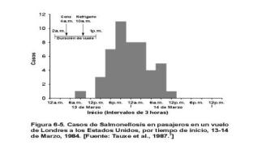
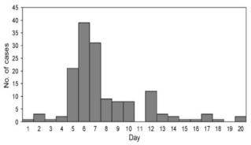
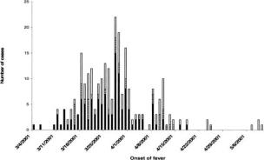
Epidemic curve
A graph displaying the number of cases per time unit during the period in which the outbreak takes place
Helps validate hypotheses on the causal agent and its incubation period
Suggest a method of transmission:
Point source
Progressive source or person-to-person transmission
Continuous common source

Slide 19
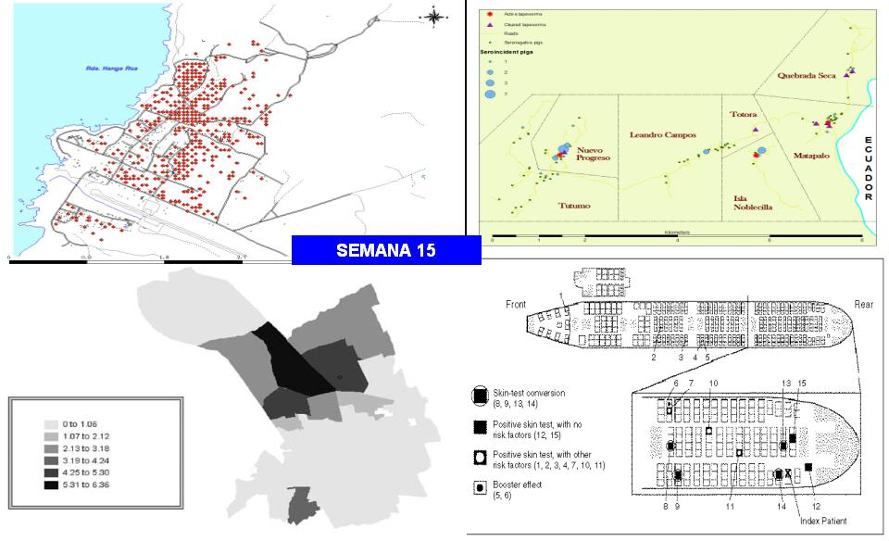
Maps and diagrams
WEEK 15

Slide 20
Person
Signs and symptoms
 | Cases (n=61)
 | n | %
Discomfort | 53 | 86.9
Headaches | 42 | 68.9
Shaking Chills | 38 | 62.3
Cough | 34 | 55.7
Abdominal pain | 31 | 50.8
Edema | 28 | 45.9
Anorexia | 27 | 44.3
Dark urine | 27 | 44.3
Dizziness | 25 | 41.0
Myalgia | 24 | 39.3
Nausea | 23 | 37.7
Vomiting | 22 | 36.1
Diarrhea | 19 | 31.1
Leg pain | 19 | 31.1
Sore throat | 19 | 31.1
Arthralgias | 18 | 29.5
Sociodemographic data
 | Cases (n=61)
 | n | %
Age
0–11 | 35 | 57.4
12–17 | 8 | 13.1
18+ | 18 | 29.5
Sex
Male | 27 | 44.3
Female | 34 | 55.7
Possible risk factors
 | Cases (n=61)
 | n | %
Bathed in Shushuna | 4 / 6 | 66.7
House Floods | 30 / 61 | 49.2
Contact with rats | 27 / 61 | 44.3
Presence of fleas | 16 / 61 | 26.2
Tick presence | 9 / 61 | 14.8
# of dogs | 2.15 ± 0.63
You never see house rats | 18 / 61 | 29.5
Attack rate (incidence)
Age Range | Cases | Population | Attack Rate (%)
5–14 | 15 | 35 | 43
15–24 | 12 | 23 | 52
25–44 | 26 | 77 | 34
Over 45 | 3 | 12 | 25
Total | 56 | 147 | 38

Slide 21
5
STEP
Determine who is at risk of illness
Select the most striking results of the descriptive epidemiology:
– Is there greater frequency of cases among males?
– Is there greater frequency among adults?
– Are they concentrated in the far north of the village?
This is useful to know who should be a priority for detection, prevention, and control
Summarize results and suggest hypothesis

Slide 22
6
STEP
Develop a hypothesis
Go back to the objectives
– Etiologic agent
– Source
– Mechanism for transmission
Hypotheses must be based on evidence collected

Slide 23
7
STEP
Evaluate the hypothesis
Compare the hypothesis with evidence obtained
Give greater weight to direct evidence (laboratory results, data from the same individuals)
Consider the epidemiological context, but remember that it is only context and not necessarily confirmation
Use common sense

Slide 24
8
STEP
Reevaluate and refine hypotheses and conduct additional studies
Reconsider available evidence
Evaluate laboratory and environmental data
Conduct analytical epidemiological studies using group comparisons
Conduct stratified analyses

Slide 25
9
STEP
Implement prevention and control measures
This should be done as soon as possible
Based on investigation results
For example:
– Treatment
– Isolation
– Quarantine
– Personal protection measures
– Immunization
– Chemoprophylaxis

Slide 26
10
STEP
Communicate the findings
Final task
Oral report for local authorities
Written report for superiors
Scientific publication for public health literature
Be cautious when dealing with the media

Slide 27
Example
Present the investigation of a recent outbreak
Show the investigation step by step, in line with the sequence shown in the presentation

Slide 28
© Pan American Health Organization, 2023
Property of the Pan American Health Organization. Reproduced with permission pursuant to the Creative Commons Attribution-NonCommercial-NoDerivs 3.0 IGO license (CC BY-NC-ND 3.0 IGO).
In any use of this work, there should be no suggestion that the Pan American Health Organization (PAHO) endorses any specific organization, product, or service. Use of the PAHO logo, in a way that is not already incorporated in the work or consistent with the Creative Commons license CC BY-NC-ND 3.0 IGO, is strictly prohibited. Any use of this work that is inconsistent with or not permitted under the Creative Commons license BY-NC-ND 3.0 IGO requires the express written consent of PAHO.
Further, all reasonable precautions have been taken by PAHO and the GS/OAS to verify the information contained in this publication. However, the published material is being distributed without warranty of any kind, either expressed or implied. The responsibility for the interpretation and use of the material lies with the reader. In no event shall PAHO and/or the OAS or GS/OAS be liable for damages arising from its use

