Slide 1
Collection and handling of human samples

Slide 2
Objectives
Know the main samples to be collected
– The most common samples in the local context
– Samples based on the outbreak syndrome
Be familiar with the sample collection method
Know the appropriate method for transporting samples
Facilitate the compilation of a list of key persons/contacts to contact in case of an outbreak

Slide 3
Content
Outbreak study with a syndromic approach
General information on sample collection
– Etiologic agent
– Success factors for isolating the etiologic agent
– Types of samples
– What should you take in the case of an outbreak?
Taking clinical samples
Conserving and transporting samples

Slide 4
General information on sample collection
One of the first and most important steps in an outbreak investigation.
Laboratory results are very valuable. They:
1.
Can help identify the causal agent
2.
Can provide information on the mode of transmission
3.
Can identify the possible origin and source of the outbreak

Slide 5
Etiologic Agent
1.
The first component necessary in the infection chain
2.
Isolating a pathogenic agent does not necessarily imply that it is the culprit of the outbreak
3.
Appropriate sample collection is fundamental

Slide 6
Etiologic agent
1.
Etiologic agent investigation:
collecting samples
transport
processing
2.
Can it be transmitted by the suspected method?
3.
Survival in the environment:
where?
how long?
does it multiply there?

Slide 7
Etiologic agent
4.
Consider other reservoirs
5.
Consider:
– Pathogenicity: the ability to produce an infection
– Virulence: the level of pathogenicity. Expressed numerically as the ratio between the number of cases of infection and the total number of infected individuals determined by immunoassay. When death is the only criteria for seriousness, this is the lethality rate.
– Antigenicity or immunogenicity: the ability to produce a specific immune response

Slide 8
Why is appropriate sample collection important?
Facilitate the laboratory’s efforts to identify the infectious agent
Discover the occurrence of asymptomatic infections and the spectrum of the disease

Slide 9
Concepts to consider in seeking the etiologic agent
Some syndromes can be caused by more than one etiologic agent. Example: meningitis
Some agents can cause various syndromes. Example: H. influenzae
Typification to demonstrate clonality. Various methods.

Slide 10
Types of agents
1.
Infectious
agents:
virus
parasites
bacteria
fungi
2.
Infectious
particles:
virions
prions
3.
Non-infectious
agents:
chemicals
toxins

Slide 11
Where is the agent?
1.
People who are sick, exposed, contacts, and carriers
2.
Environment
3.
Reservoirs and food
4.
Vectors

Slide 12
What kind of sample to collect?
The type of sample to be collected will depend on the suspected etiological agent(s)
This should be supported by investigation findings
All samples shall be taken from different sources, pursuant to the implied mode of transmission

Slide 13
Success factors in isolating the etiologic agent
Advance planning
The sample should represent the actively infected site (anatomically correct)
Type of sample, collection method, and appropriate materials
Sufficient quantity, avoiding contamination
Appropriate transport

Slide 14
Success factors in isolating the etiologic agent
Appropriate labeling: information based on the protocol. Example: name, site, type, date, initials of whom collected the sample
Swift transport
– bacteria < 24 hours
– virus: 2 to 3 days at -4°C
Send to a clinical laboratory: appropriate analysis technique
Biosecurity measures

Slide 15
Advance planning
Determine the outbreak’s possible etiologic agent(s). BASED ON AVAILABLE EVIDENCE
Define type(s) of samples and periodicity. BASED ON AVAILABLE EVIDENCE
Identify the laboratory(ies) where samples should be sent
Determine who will collect the sample(s)
Identify transport procedures, appropriate sample handling, and communicate this information

Slide 16
Types of samples
Types of clinical samples
1.
Exudated:
nasopharyngeal
pharyngeal
ophthalmological
aural
2.
Sterile liquids:
pleural
pericardiac
peritoneal
CSF
urine
3.
Feces:
fresh
swabbed
4.
Tissue
5.
Whole blood, serum, coagulate

Slide 17
Types of samples
Types of environmental samples
1.
Food
2.
Water:
drinking water
wastewater
bodies of water
3.
Environmental:
soil
air
surface

Slide 18
What to take in case of an outbreak?
1
2
Vacuum extraction tubes without additives
Vacuum extraction tubes with sodium citrate
3
4
Vacuum extraction tubes with EDTA
Needles for blood vacuum extraction
5
6
Disposable syringes (10, 5, 1 cc) with needle (21-26 G)
Vacuum extraction caps

Slide 19
What to take in case of an outbreak?
7
8
Sterile polypropylene 2ml cryovials
Hydrophilic cotton
9
10
Cotton swabs
Calcium alginate swabs
11
12
Sterile lancets
Containers for sharps

Slide 20
What to take in case of an outbreak?
13
14
Carbon agar transport medium
Sterile Pasteur pipettes
15
16
Sterile gauze
Slide film
17
18
Adhesive bandages
Surgical gloves size S, M, and L
19
20
Permanent markers
Labels

Slide 21
What to take in case of an outbreak?
21
22
70% alcohol
Container for contaminated material
23
24
Autoclavable biosecurity bags
Paper towels
25
26
Culture media (for example: hemoculture, Leptospira, influenza)
Toilet paper
27
28
Strains transport medium
Screw top containers (urine and feces)

Slide 22
What to take in case of an outbreak?
29
30
Formaldehyde
Glycerin
31
32
Physiological serum 0.85%
Labels
33
34
Notebook
Scalpel
35
36
Thermal boxes
Batteries for refrigeration

Slide 23
Outbreak study with a syndromic approach
Logical approach to collecting information on an outbreak
Timely identification of the presence of disease
Evaluate the disease diagnosis based on geographical area and clinical evolution
Syndromic approach guides the development of the etiological approach

Slide 24
Taking clinical samples
Nasal swabs
Swabs for posterior pharynx
Cerebral spinal fluid (CSF)

Slide 25
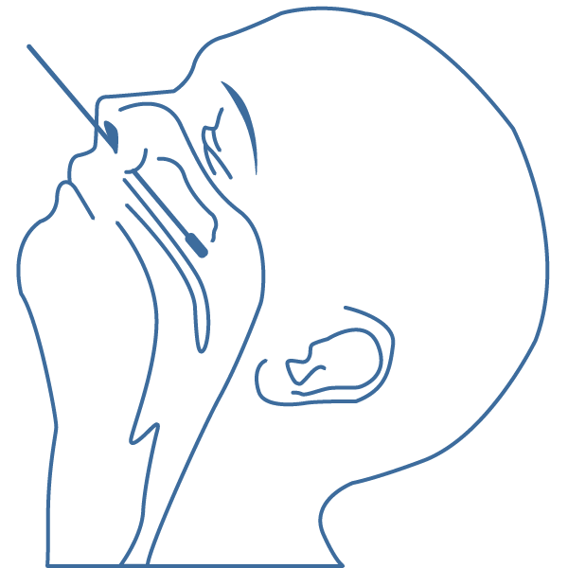
Nasal swabs
Lean the patient’s head back
Introduce a dry swab into the nasal cavity and take it to the nasopharynx
Pause there for a few seconds
Slowly remove the swab as you lightly turn it
Introduce the swab into the corresponding tube, break the end off of the swab, and hermetically seal the tube
Notes:
Next, we will describe how to take a sample of nasopharyngeal swabs.
First, insert a rayon or polyester swab into the nasal cavity and bring it backward, into the nasopharynx.
Hold the swab there for a few seconds.
Then, remove the swab while gently rotating it.

Slide 26
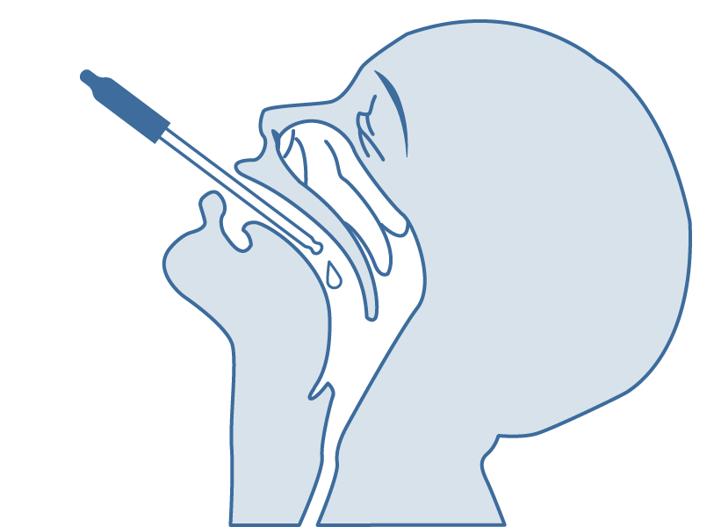
Posterior pharynx swabs
Garganta
Open the mouth
Hold the tongue down with the tongue depressor
Using a swab, take a sample from the posterior pharynx
Avoid any contact with the tonsils
Throat
Notes:
Next, we will describe how to take samples from the posterior pharynx. The posterior pharynx is the area at the back of the throat, behind the tonsils.
First, ask the subject to open their mouth.
Then, lower the subject's tongue using a tongue depressor.
With a swab, take a sample from the posterior pharynx, avoiding contact with the tonsils.

Slide 27
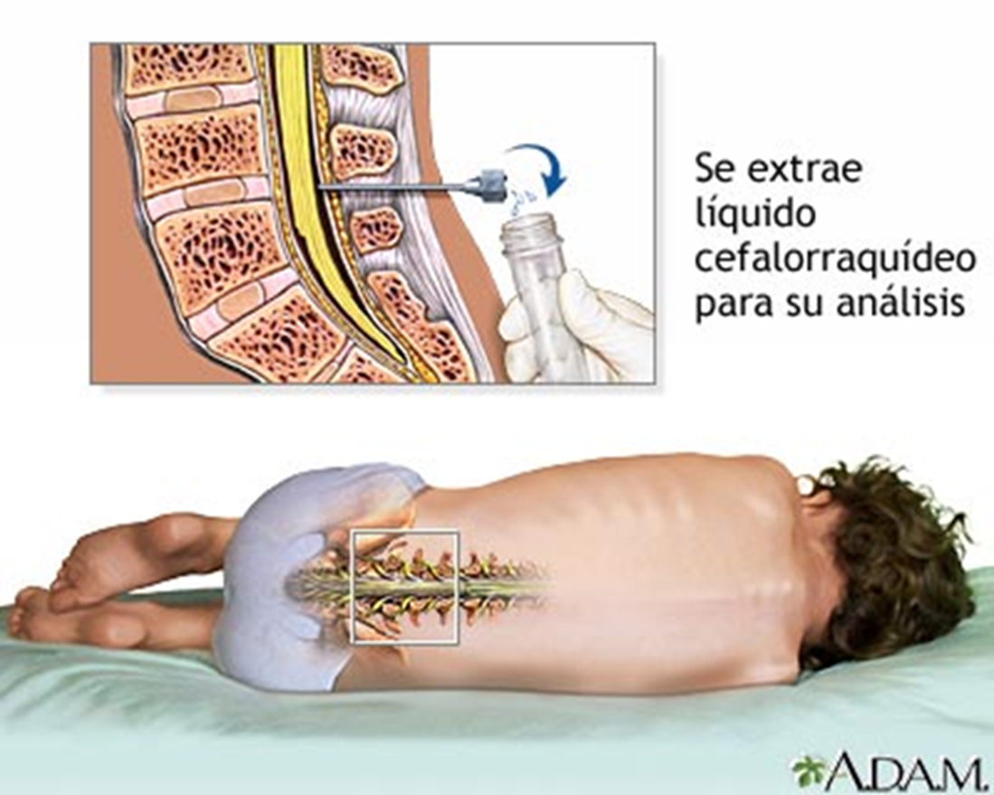
CSF samples
Volume 2-3ml
3 Tubes, sterile tubes with a screw top:
– Tube 1: Chemical analysis
– Tube 2: Microbiological
– Tube 3: Appearance and cell count
Cerebrospinal fluid is removed for analysis

Slide 28
Conserving and transporting samples
Type of sample | Shipping temperature (°C) | Shipping time (h) | Conservation in the lab
Serum | 4 to 8 | 24 to 48 | Serology: -20°C
 |  |  | Viral isolation or PCR: -70°C
Nasal and pharyngeal swab | 4 to 8 | 24 | Viral isolation or PCR: -70°C
Feces | 4 to 8 | 24 | Culture: 4 °C
 |  |  | Viral isolation or PCR: -70°C
Cerebrospinal fluid | Bacteriology: TA | immediate
 | Virus: 4 to 8
Blood for hemoculture | TA |  | Protect from light
Tissue | Frozen: –20 °C | no > 48 h
 | Fixed: TA

Slide 29
In case of death
Blood from heart or large vessels
Tissue: liver, lungs, or other organs:
– Frozen tissue: RT-PCR – viral isolation
– Fixed tissue in buffered formalin solution or embedded in paraffin: immunohistochemical

Slide 30
Conserving and transporting samples
Serum
Temperature from 4 to 8°C to be shipped to the laboratory within 24 to 48 hours
In the laboratory: To be frozen at -20°C for serology or to -70°C for viral isolation or PCR if the sample will not be processed rapidly

Slide 31
Conserving and transporting samples
Nasal and pharyngeal swab
Temperature of 4 to 8°C to be shipped to the laboratory within 24 hours
In the laboratory: To be frozen to –70°C for viral isolation or PCR if it will not be processed rapidly, cannot be frozen for IFI

Slide 32
Conserving and transporting samples
Feces
Temperature of 4 to 8°C to be shipped to the laboratory within 24 hours
In the laboratory: To be frozen to –70°C

Slide 33
Conserving and transporting samples
CSF
To be transported to the laboratory immediately
Should never be refrigerated for bacteriology
For virus, to be shipped at 4 to 8°C

Slide 34
Conserving and transporting samples
Hemocultures
To be transported to the laboratory at ambient temperature
Protect from direct light

Slide 35
Conserving and transporting samples
Tissue
Frozen tissue
– Local conservation at -20°C (no more than 48 h)
– To be shipped in dry ice
Fixed tissues
– To be shipped at ambient temperature

Slide 36
Indications for shipping samples
To be shipped in triple-packed, plastic, hermetic containers
Containers should indicate the following information:
– Patient’s individual indicator, to be duly registered on a master list
– Type of sample
– Date of sample collection
– Date of the onset of symptoms and signs
– Conditions for maintaining the sample
Inform the laboratory of the date of shipment, expected time of arrival, and means of transport

Slide 37
© Pan American Health Organization, 2023
Property of the Pan American Health Organization. Reproduced with permission pursuant to the Creative Commons Attribution-NonCommercial-NoDerivs 3.0 IGO license (CC BY-NC-ND 3.0 IGO).
In any use of this work, there should be no suggestion that the Pan American Health Organization (PAHO) endorses any specific organization, product, or service. Use of the PAHO logo, in a way that is not already incorporated in the work or consistent with the Creative Commons license CC BY-NC-ND 3.0 IGO, is strictly prohibited. Any use of this work that is inconsistent with or not permitted under the Creative Commons license BY-NC-ND 3.0 IGO requires the express written consent of PAHO.
Further, all reasonable precautions have been taken by PAHO and the GS/OAS to verify the information contained in this publication. However, the published material is being distributed without warranty of any kind, either expressed or implied. The responsibility for the interpretation and use of the material lies with the reader. In no event shall PAHO and/or the OAS or GS/OAS be liable for damages arising from its use

