Slide 1
Role of vectors in disease transmission

Slide 2
Objectives
Know the main characteristics of vectors and identify different types
Know the transmission mechanism of the main etiological agents by vectors

Slide 3
Content
Definition of vector
Role of the vector
Definition of zoonosis
Types of vectors
Transmission mechanism
Vector capacity
Agents transmitted by vectors

Slide 4
Vector definition
Vector
An organism that transmits an infectious agent or infectant from affected individuals to others who do not yet carry that agent.
Hematophagous arthropod
Epidemiology
Parasitology
Ecology

Slide 5
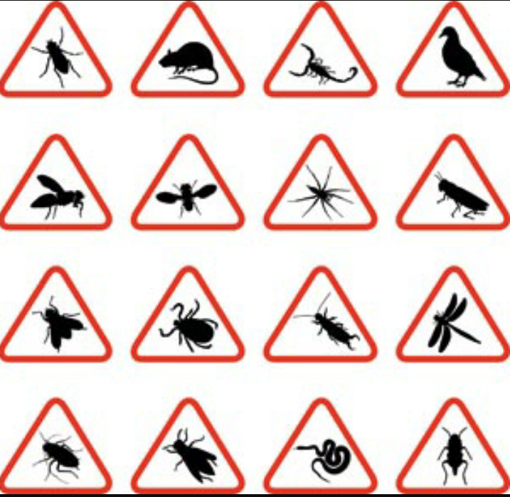
Role of the vector
In practice
Host
Intermediary
Etiologic agent
Susceptible human

Slide 6
Definition of zoonoses
Zoonosis
Sick animal as an agent reservoir
Susceptible human

Slide 7
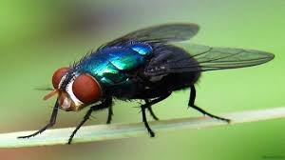
Types of vectors
MECHANICAL VECTOR
– The etiologic agent does not multiply or change within the vector.
– The vector transports the agent in its feet or fur, or the agent passes through its digestive tract without undergoing any alterations before it is excreted.

Slide 8
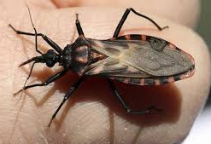
Types of vectors
BIOLOGICAL VECTOR
– The etiologic agent multiplies within the arthropod, changes, or goes through a cycle before it becomes an infectant for humans.

Slide 9
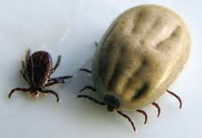
Types of vectors
RESERVOIR VECTOR
– Where the agent may be transmitted from one generation to the next through transovarian transmission.

Slide 10
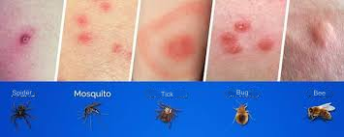
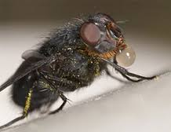
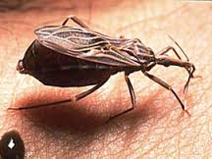
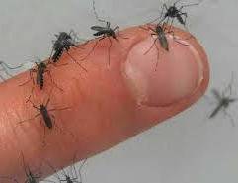
Transmission mechanisms
Stings
Regurgitation
Scratching infective feces
Fluids from the vector organism

Slide 11
Vector capability
A vector’s suitability for effective transmission, determined by several factors of the vector, agent, environment, and recipient.
FACTORS DEPENDENT ON THE VECTOR | FACTORS DEPENDENT ON THE AGENT | FACTORS DEPENDENT ON THE MEDIUM
Susceptibility Vector persistence Anthropophilia Domesticity Type of vector (biological or mechanical) Transmission mechanism Abundance Biology Ecology | Availability of reservoirs Affinity for the vector Vector multiplication capacity Parasite load Pathogenicity | Climate Relief Hydrography Housing Contamination Human population Reservoirs Human activity

Slide 12
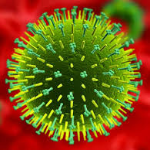
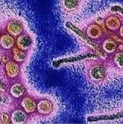
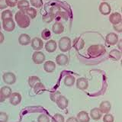
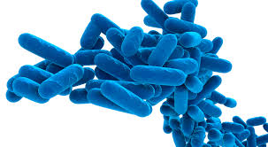
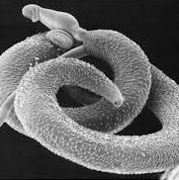
Agents transmitted by vectors
Virus
Rickettsia
Bacteria
Protozoans
Helminths

Slide 13
© Pan American Health Organization, 2023
Property of the Pan American Health Organization. Reproduced with permission pursuant to the Creative Commons Attribution-NonCommercial-NoDerivs 3.0 IGO license (CC BY-NC-ND 3.0 IGO).
In any use of this work, there should be no suggestion that the Pan American Health Organization (PAHO) endorses any specific organization, product, or service. Use of the PAHO logo, in a way that is not already incorporated in the work or consistent with the Creative Commons license CC BY-NC-ND 3.0 IGO, is strictly prohibited. Any use of this work that is inconsistent with or not permitted under the Creative Commons license BY-NC-ND 3.0 IGO requires the express written consent of PAHO.
Further, all reasonable precautions have been taken by PAHO and the GS/OAS to verify the information contained in this publication. However, the published material is being distributed without warranty of any kind, either expressed or implied. The responsibility for the interpretation and use of the material lies with the reader. In no event shall PAHO and/or the OAS or GS/OAS be liable for damages arising from its use

