Slide 1
Reservoir studies

Slide 2
Objectives
Understand the importance of reservoir studies
Be familiar with examples of studies conducted in the field

Slide 3
Content
Definition of zoonosis
Emerging zoonosis
The role of small mammals
Definition of reservoir
Main viruses transmitted by small mammals
Ecological studies in reservoirs
Trapping and processing small mammals

Slide 4
Definition of Zoonosis
Zoonosis in Ancient Greek
– zoon (animal) + nosos (diseases)
– Only diseases in animals
1855, Zoonosis: Infections caused by animal poisons (Virchow)
– Diseases in animals and
– Human diseases stemming from animals, through a vector or contact
WHO [1956]: Diseases and infections transmitted naturally between vertebrate animals and human beings, with or without an intermediary host

Slide 5
Emerging zoonosis
1415 species of infectious agents causing diseases in humans have been reported
– Viruses, prions, bacteria, rickettsia, fungi, protozoa, helminths
It is known that 868 (61%) of them are zoonotic
175 species are considered “emerging”
– 132 (75%) are considered zoonotic
Taylor et al. Risk factors for the emergence of diseases. 2001, Philosophical Transactions, The Royal Society, London

Slide 6
How do infectious agents cross the species barrier?
They are “competent” to infect human beings
Same genome, humans or animals
Wide number of hosts
– West Nile virus
– Avian influenza virus H5N1, 2004
– Ebola
They go through major genomic changes
Increased range of hosts
Increased efficiency in transmission
– SARS CoV
– Influenza A virus H1N1, 1918

Slide 7
Zoonosis: Transmission routes
Transmitted by arthropods
Arbovirus
Contact with animals
Bacillus anthracis
Contact with substances of animal origin
Coxiella burnetii
Contact with urine
Leptospira
spp
Fecal-oral
Salmonella
spp
Bites and scratches
Bartonella
henselae
Ingesting poorly cooked meat
Trichinella
spp
Dairy consumption
Mycobacterium
bovis
Respiratory
Yersinia
pestis
Transfusion and transplant
West Nile
virus
Notes:
Examples:
- Arbovirus – yellow fever
- Coxiella burnetti: Q fever - Cattle, sheep, and goats are the primary reservoirs. Organisms are excreted in milk, urine, and feces of infected animals. Most importantly, during birth (amniotic fluids and the placenta). The organisms are resistant to heat, drying, and many common disinfectants. These features enable the bacteria to survive for long periods in the environment. Infection of humans usually occurs by inhalation of these organisms from air
- Bartonella henselae: cat scratch disease
- Trichinella sp: Trichinellosis, also called trichinosis, is caused by eating raw or undercooked meat of animals infected with the larvae of a species of worm called Trichinella. Infection occurs commonly in certain wild carnivorous (meat-eating) animals but may also occur in domestic pigs.
- Mycobacterium bovis: important cause of tuberculosis transmitted by consumption of unpasteurized milk, although it can also be by the respiratory route. Another agent for consumption of unpasteurized milk and cheese is Brucella spp. although the infection is predominantly occupational
- Transplant: also some documented cases of rabies

Slide 8
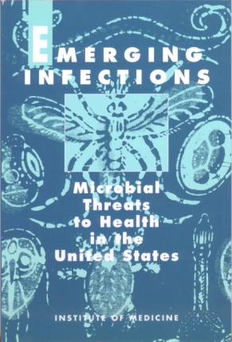
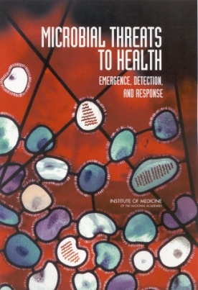
Factors that contribute to the emergence and re-emergence of zoonotic diseases
Medical advancements
– Immunocompromised persons
Air travel
– Greater movement of persons
– Greater trade of animals/animal products
Neglect of monitoring or control activities
Microbial adaptation and changes

Slide 9
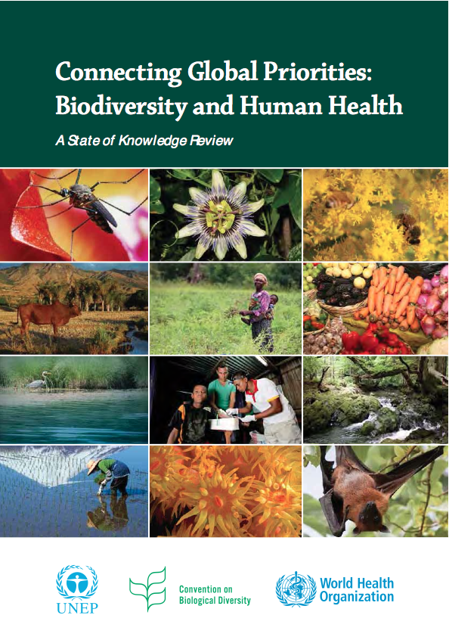
Factors that contribute to the emergence and re-emergence of zoonotic diseases
Changes at the local and global level
– Changes in soil use
– Loss of biodiversity
– Atmospheric phenomena
– Climate change

Slide 10
The role of small mammals
Small mammals (rodents, bats, etc.) as major reservoirs of zoonotic diseases
– High diversity
– Opportunistic
– High reproduction potential
– High population density
– Peridomestic affinity

Slide 11
Definition of reservoir
Person, animal, arthropod, plant, soil, or substance
Agent lives and multiplies
Dependent for survival
Can be transmitted to a susceptible host
Notes:
Any person, animal, arthropod, plant, soil, or substance, or combination of these in which an infectious agent normally lives and multiplies, on which is dependent for survival, and where it reproduces itself in such a manner that it can be transmitted to a susceptible host.

Slide 12
Main viruses transmitted by small mammals
Diseases caused by Rickettsia and transmitted by rodents
Bacterial diseases transmitted by rodents
Diseases caused by Protozoa and transmitted by rodents
Viral diseases transmitted by rodents
Viral and mycotic diseases transmitted by chiroptera
Notes:
- Rocky mountain spotted fever: illness caused by Rickettsia rickettsii, a bacterial pathogen transmitted to humans through contact with ticks. Dermacentor species of ticks are most commonly associated with infection, including Dermacentor variabilis (the American dog tick), Dermacentor andersoni (the Rocky Mountain wood tick), and more recently Rhiphicephalus sanguineus (the brown dog tick).
- Mediterranean botonosa fever (produced by R. conorii)
- Scrub typhus: scrub typhus, agent: Orientia tsutsugamushi. Typhoid fever caused by mites.
- Rickettsia typhi causes murine typhus or endemic typhus. Endemic typhus is sometimes called "exanthematic typhus."

Slide 13
Main diseases caused by Rickettsia and transmitted by rodents
Disease | Distribution | Primary reservoir
Rocky Mountain spotted fever | America | Various
Boutonneuse fever | Europe / Asia / Africa | Various
Scrub typhus | Asia | Rattus spp
Murine typhus | Global | Rattus spp

Slide 14
Main bacterial diseases transmitted by rodents
Disease | Distribution | Primary reservoir
Recurring fever due to tick bite | Global | Various
Lyme disease | Global? | P. leucopus & others
Leptospirosis | Global | R. norvegicus & others
Plague | Widely distributed | Rattus spp / Sciuridae
Salmonellosis | Global | Rattus spp

Slide 15
Main diseases caused by Protozoa and transmitted by rodents
Disease | Distribution | Primary reservoir
Toxoplasmosis | Global | Rattus sp / Mus sp
Leishmaniasis | Asia / Africa / America | Rattus and others
Chagas disease | Latin America | Rattus sp and others

Slide 16
Main viral diseases transmitted by rodents
Disease | Distribution | Primary reservoir
Lassa fever | Africa | Mastomys sp
Argentine hemorrhagic fever | Argentina | Calomys musculinus
Bolivian hemorrhagic fever | Bolivia | C. callosus
Venezuelan hemorrhagic fever | Venezuela | Z. brevicauda
LCMV | Global | Mus musculus
Hemorrhagic fever with renal syndrome | Europe / Asia | Muridae
Hantavirus pulmonary syndrome | America | Sigmodontinae
EEV | America | Sigmodontinae
Tick-borne encephalitis | Europe / Asia | Muridae

Slide 17
Main viral and mycotic diseases transmitted by chiroptera
Disease | Distribution | Primary reservoir
Nipah virus | Southeast Asia, Bangladesh | Pteropus sp
Hendra virus | Australia | Pteropus sp
Menagle virus | Australia | Pteropus sp
Rabies | Global | Various
Ebola | Africa | Various frugivores
Histoplasmosis | Global | Various
Notes:
Ebola (Zaire Virus): The hammer-headed fruit bat (Hypsignathus monstrosus), Franquet's epauletted fruit bat (Epomops franqueti), and the little collared fruit bat (Myonycteris torquata)

Slide 18
Ecological studies in reservoirs
Comprehensive approach
Efficient use of resources and data
Investigator’s safety
Notes:
A consistent and comprehensive approach for reservoir research to contribute to the efficient use of resources and collected data, as well as to investigator safety

Slide 19
Ecological studies in reservoirs
Multidisciplinary approach:
– Ecology
– Epidemiology
– Human and animal medicine
– Microbiology

Slide 20
Geographic distribution of the host
Distribution of the host and pathogen among various habitats
RESERVOIRS
STUDIES
Time and space patterns in the host-pathogen dynamic
Development of predictive models
Prevalence of infection among host sub-populations
Geographic range of the pathogen within the range of the host
Notes:
Geographical distribution of the host
Defines the maximum area where a disease can be endemic
Temporal dynamics of host-pathogen populations
Identify: a) effects of infection in individuals and host species populations, b) seasonal and yearly fluctuation of incidence and prevalence and duration of infection in host, and c) environmental variables associated to changes in host density or transmission rates
Distribution of the pathogen among different habitats
Indicates risk for human infection in several habitats within a geographic region
Relative frequency of infection in host subpopulations
Suggests potential transmission mechanisms of the pathogen among host populations
Geographical distribution of the pathogen within the host range
The geographic area extension where the infected host can be found, indicates where the are humans, disease can be endemic
Predictive models
The goal of reservoir ecological studies is to integrate and apply data to the development or refinement of predictive models that help public health authorities to identify specific periods and places that present a threat to public health

Slide 21
Trapping and processing small mammals
Prior planning:
– Capture permits and animal care and use protocols approved
– Check equipment and shipment list

Slide 22
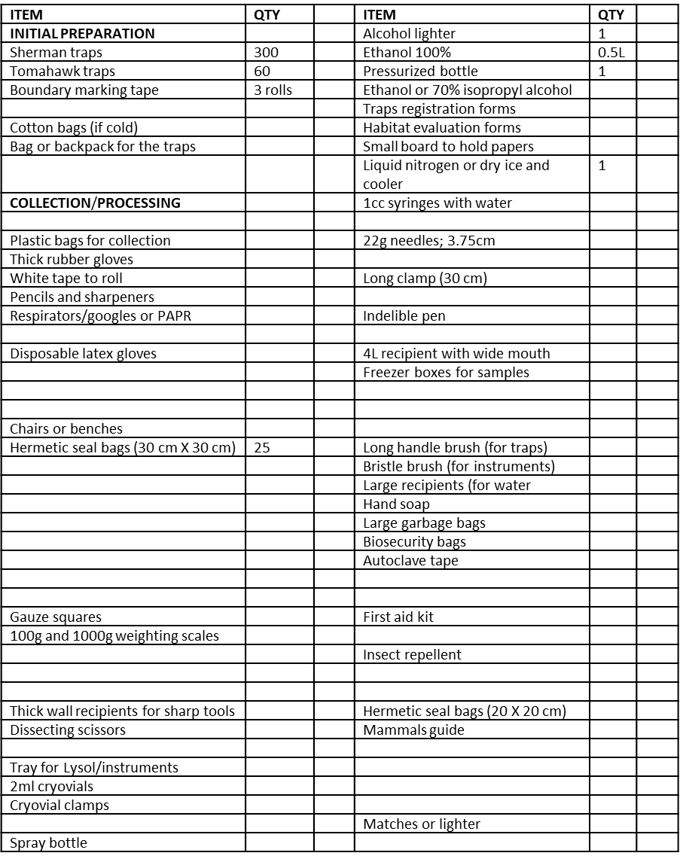
Trapping and processing small mammals
MATERIALS CHECKLIST
(Minimum quantity for three technicians to process 100 animals)
Notes:
Example checklist obtained from the manual METHODS FOR TRAPPING AND SAMPLING OF SMALL MAMMALS FOR VIROLOGICAL STUDIES
This manual was prepared by the following people: Dr. James N. Mills Dr. James E. Childs Dr. Thomas G. Ksiazek Dr. C.J. Peters Division of Viral Diseases and by Rickettsias National Center for Infectious Diseases Sr. Wallis M. Velleca. Laboratory Systems Division

Slide 23
Trapping and processing small mammals
Preparing and reviewing traps
Preparation for capture
Trap location
Collecting captured animals

Slide 24
Trapping and processing small mammals
Processing captured rodents/mammals
Selecting a location for processing
Preparing sample spreadsheets
Blood collection
Obtaining reproductive and morphometric measures
Decontaminating traps
Cleaning traps
Verifying sample spreadsheets
Sending samples

Slide 25
Trapping and processing small mammals
Consider:
Use PPE to handle traps
Ensure that the species captured are of interest to the study
For trap collection: traps should be double bagged
For transport by vehicle: animals should be in a separate compartment from personnel
For the field laboratory: the processing site should be far from human activity
Notes:
Take into consideration:
- Use PPE to handle traps
- Ensure that the species captured are of interest the study
- For the collection of traps: Traps should be double bagged
- For transport by vehicle: place the animals in a different compartment than the staff
- For the field laboratory: Choose a processing site that is away from human activities

Slide 26
Trapping and processing small mammals
Anesthesia and blood collection
Morphometric measures
Tattooing
Necropsy stations

Slide 27
Types of traps for small mammals
Live capture traps (rodents)
Mist nets (bats, birds)
Blowgun, rifle, or darts (medium to large wild animals)

Slide 28
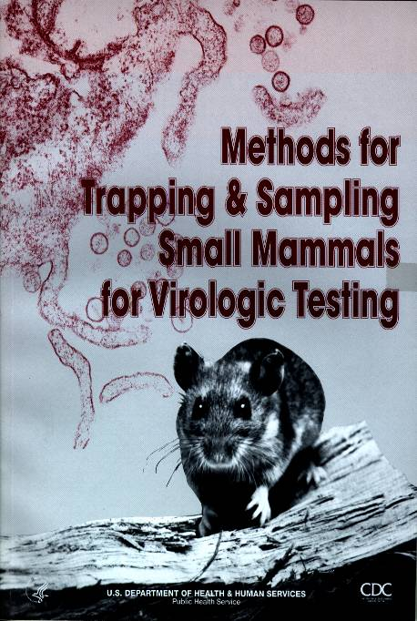
“Methods for trapping and sampling small mammals for virological studies”
http://www.cdc.gov/ncidod/dvrd/spb/mnpages/rodentmanual.htm

Slide 29
© Pan American Health Organization, 2023
Property of the Pan American Health Organization. Reproduced with permission pursuant to the Creative Commons Attribution-NonCommercial-NoDerivs 3.0 IGO license (CC BY-NC-ND 3.0 IGO).
In any use of this work, there should be no suggestion that the Pan American Health Organization (PAHO) endorses any specific organization, product, or service. Use of the PAHO logo, in a way that is not already incorporated in the work or consistent with the Creative Commons license CC BY-NC-ND 3.0 IGO, is strictly prohibited. Any use of this work that is inconsistent with or not permitted under the Creative Commons license BY-NC-ND 3.0 IGO requires the express written consent of PAHO.
Further, all reasonable precautions have been taken by PAHO and the GS/OAS to verify the information contained in this publication. However, the published material is being distributed without warranty of any kind, either expressed or implied. The responsibility for the interpretation and use of the material lies with the reader. In no event shall PAHO and/or the OAS or GS/OAS be liable for damages arising from its use

