Slide 1
Contingency tables and measures of association

Slide 2
Objectives
Suggest and respond to hypotheses about the outbreak, using data collected
Interpret the statistical and epidemiological results of hypothesis tests
Reach appropriate conclusions, based on the results obtained

Slide 3
Content
Types of study
EpiDat
– Relative risk (RR)
– Confidence interval (CI)
– P value
– Odds ratio (OR)
– Stratification
Table 2 x 2

Slide 4
Initial concepts
Without a comparison group, our ability to respond to an investigation question is very limited
A numerical difference is not necessarily clinically relevant or statistically significant
Nothing is definitive, everything is in terms of probability, and being wrong is always a possibility

Slide 5
Types of studies
Type of study | Retrospective cohort | Control case
Calculate | Attack rate | Odds (chances) or odds ratio
Comparison groups | Exposed vs not exposed | Cases vs controls

Slide 6
2x2 Table
 | Sick | Healthy
Exposed | a | b
Not exposed | c | d

Slide 7
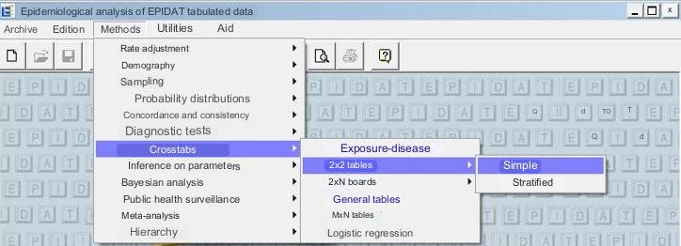
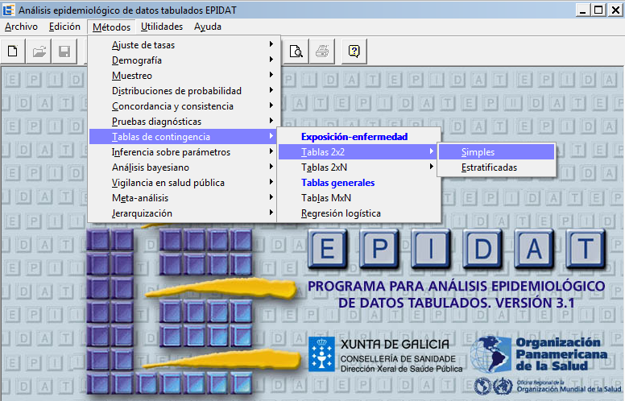
EpiDat
EpiDat 3.1
www1.paho.org/spanish/sha/epidat.htm

Slide 8
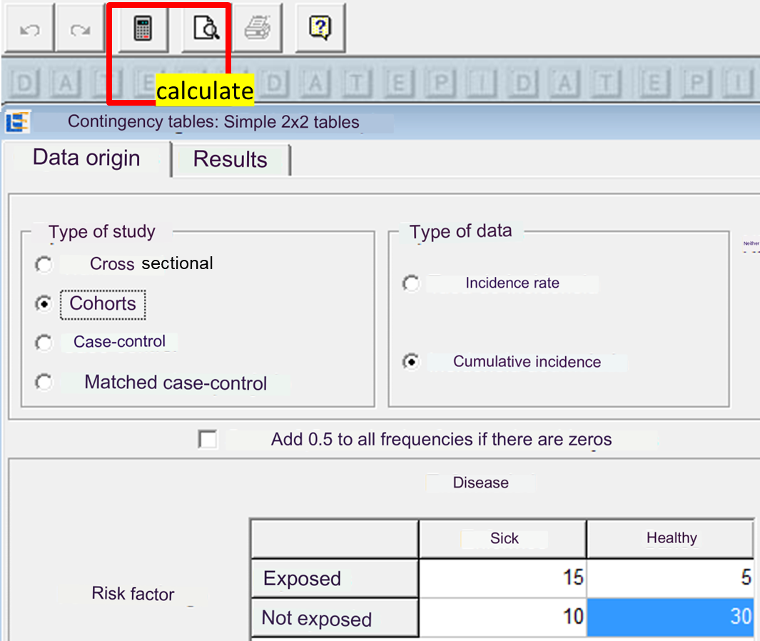
2x2 tables, Entering data and calculating

Slide 9
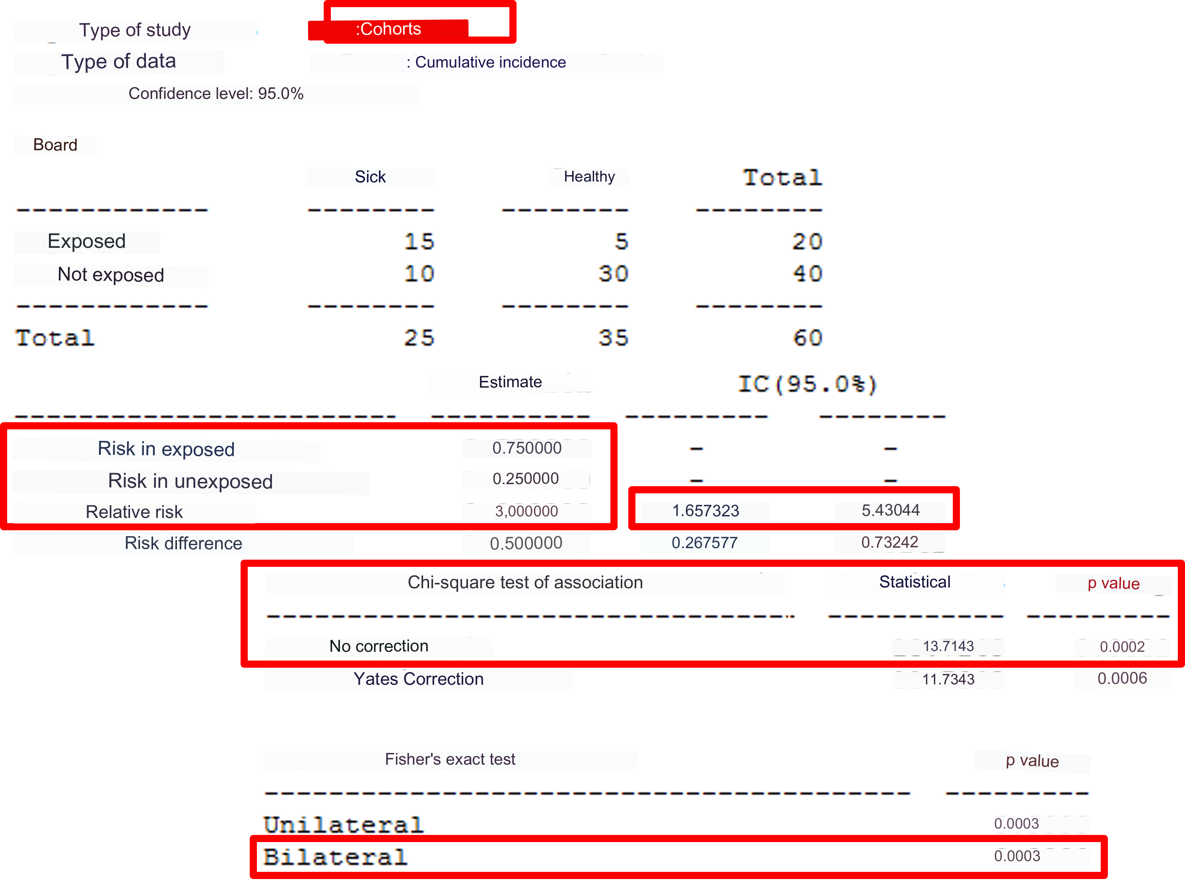
Results

Slide 10
Interpreting RR alone
Possible values
Suggests greater risk
0
1
∞
Suggests protection

Slide 11
Interpreting the confidence interval (CI) of relative risk
If the total CI is less than 1, those exposed have statistically less risk with 95% confidence
If the CI includes 1, there is no statistical evidence that the factor impacts risk
0
1
∞
If the CI includes 1, there is no statistical evidence that the factor impacts risk
If the total CI is greater than 1, those exposed have a statistically significant greater risk with 95% confidence

Slide 12
Example results
1.66
3.00
5.43
0
1
∞
How much more risk? On average, the risk is 3 times greater for those who were exposed compared to those who were not
The confidence interval does not include the unit. With 95% confidence, the RR is greater than 1 (more risk for those exposed)
The RR is not necessarily 3.0: generally, it can be any value of the Interval from 1.7 to 5.4, with 95% confidence

Slide 13
What does the “p” value mean?
It can be interpreted as “the probability of obtaining an RR as observed, assuming that the factor is NOT associated with the disease”
If the p is high, the factor is probably NOT associated with the disease
If the p is low, the factor probably IS associated with the disease
p

Slide 14
Interpreting the p value alone
Possible values
p = 0.0002
There is no evidence the factor is associated with a disease
0.00
0.05
1.00
The factor is associated with a disease
The p value may not be 0. If the result is p=0.000, that means that it is very small and should be reported as p<0.0001

Slide 15
Interpreting the p value
Use the bilateral p value from the exact Fisher test, which is better for small samples
If p < 0.05, the association between the factor and the disease is “statistically significant”, that is, they are statistically relevant
Therefore, the exposure is “associated” with a greater (RR>1) risk of disease. This constitutes statistical evidence.
A value p < 0.05 almost always corresponds to a confidence interval that does not include 1
p

Slide 16
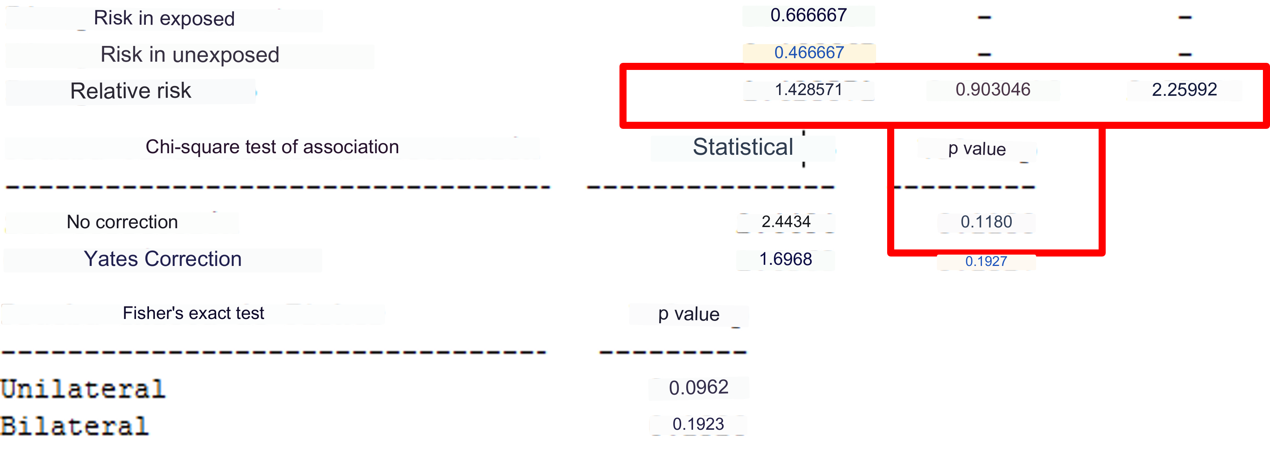
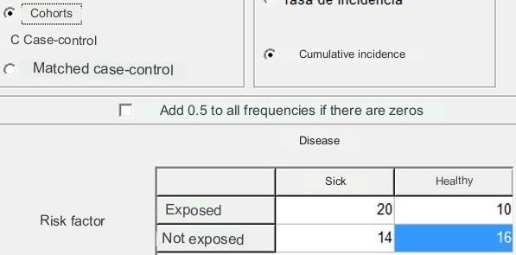
Another example

Slide 17
Interpreting results
Relative risk
0.90
1.43
2.26
0
1
∞
Value p = 0.118, coincides with the interpretation of the confidence interval that includes 1

Slide 18
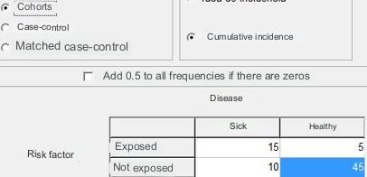
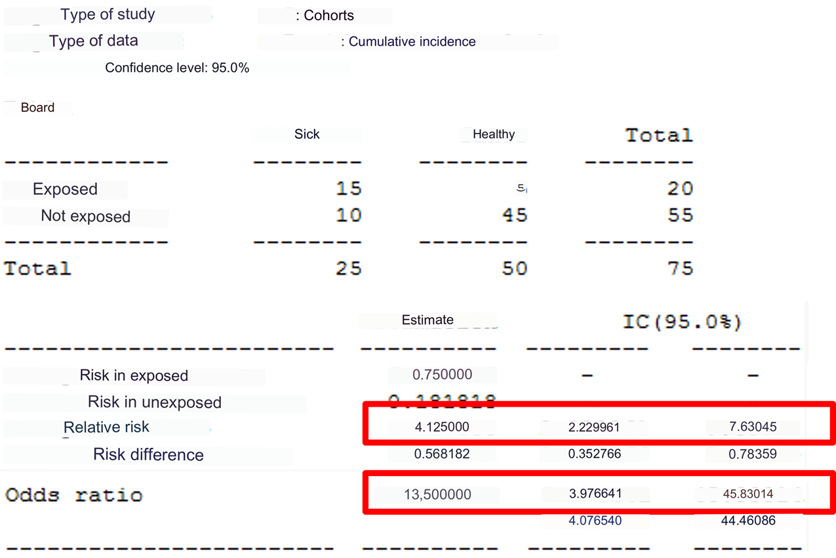
OR overestimates risk in cohort (or transversal) studies

Slide 19
Interpreting the OR confidence interval (CI)
If the total CI is less than 1, presence of the factor is significantly associated with less risk (p<0.05)
If the CI includes 1, there is no statistical evidence that the factor alters risk
(p >= 0.05)
0
1
∞
If the CI includes 1, there is no statistical evidence that the factor alters risk
(p >= 0.05)
If the total CI is greater than 1, presence of the factor is significantly associated with greater risk (p<0.05)

Slide 20
Interpreting results
OR (odds ratio)
3.98
13.50
45.83
0
1
∞
Value p < 0.0001, coincides with a confidence interval that is entirely above 1

Slide 21
Odds ratio
The confidence interval is interpreted the same way as relative risk in terms of its range and inclusion of the unit
Like the RR, the odds ratio also quantifies the strength of association between exposure and effect (in this case, the disease), and is occasionally an approximation of relative risk
Ratio between the evidence in favor of an association and the evidence against an association

Slide 22
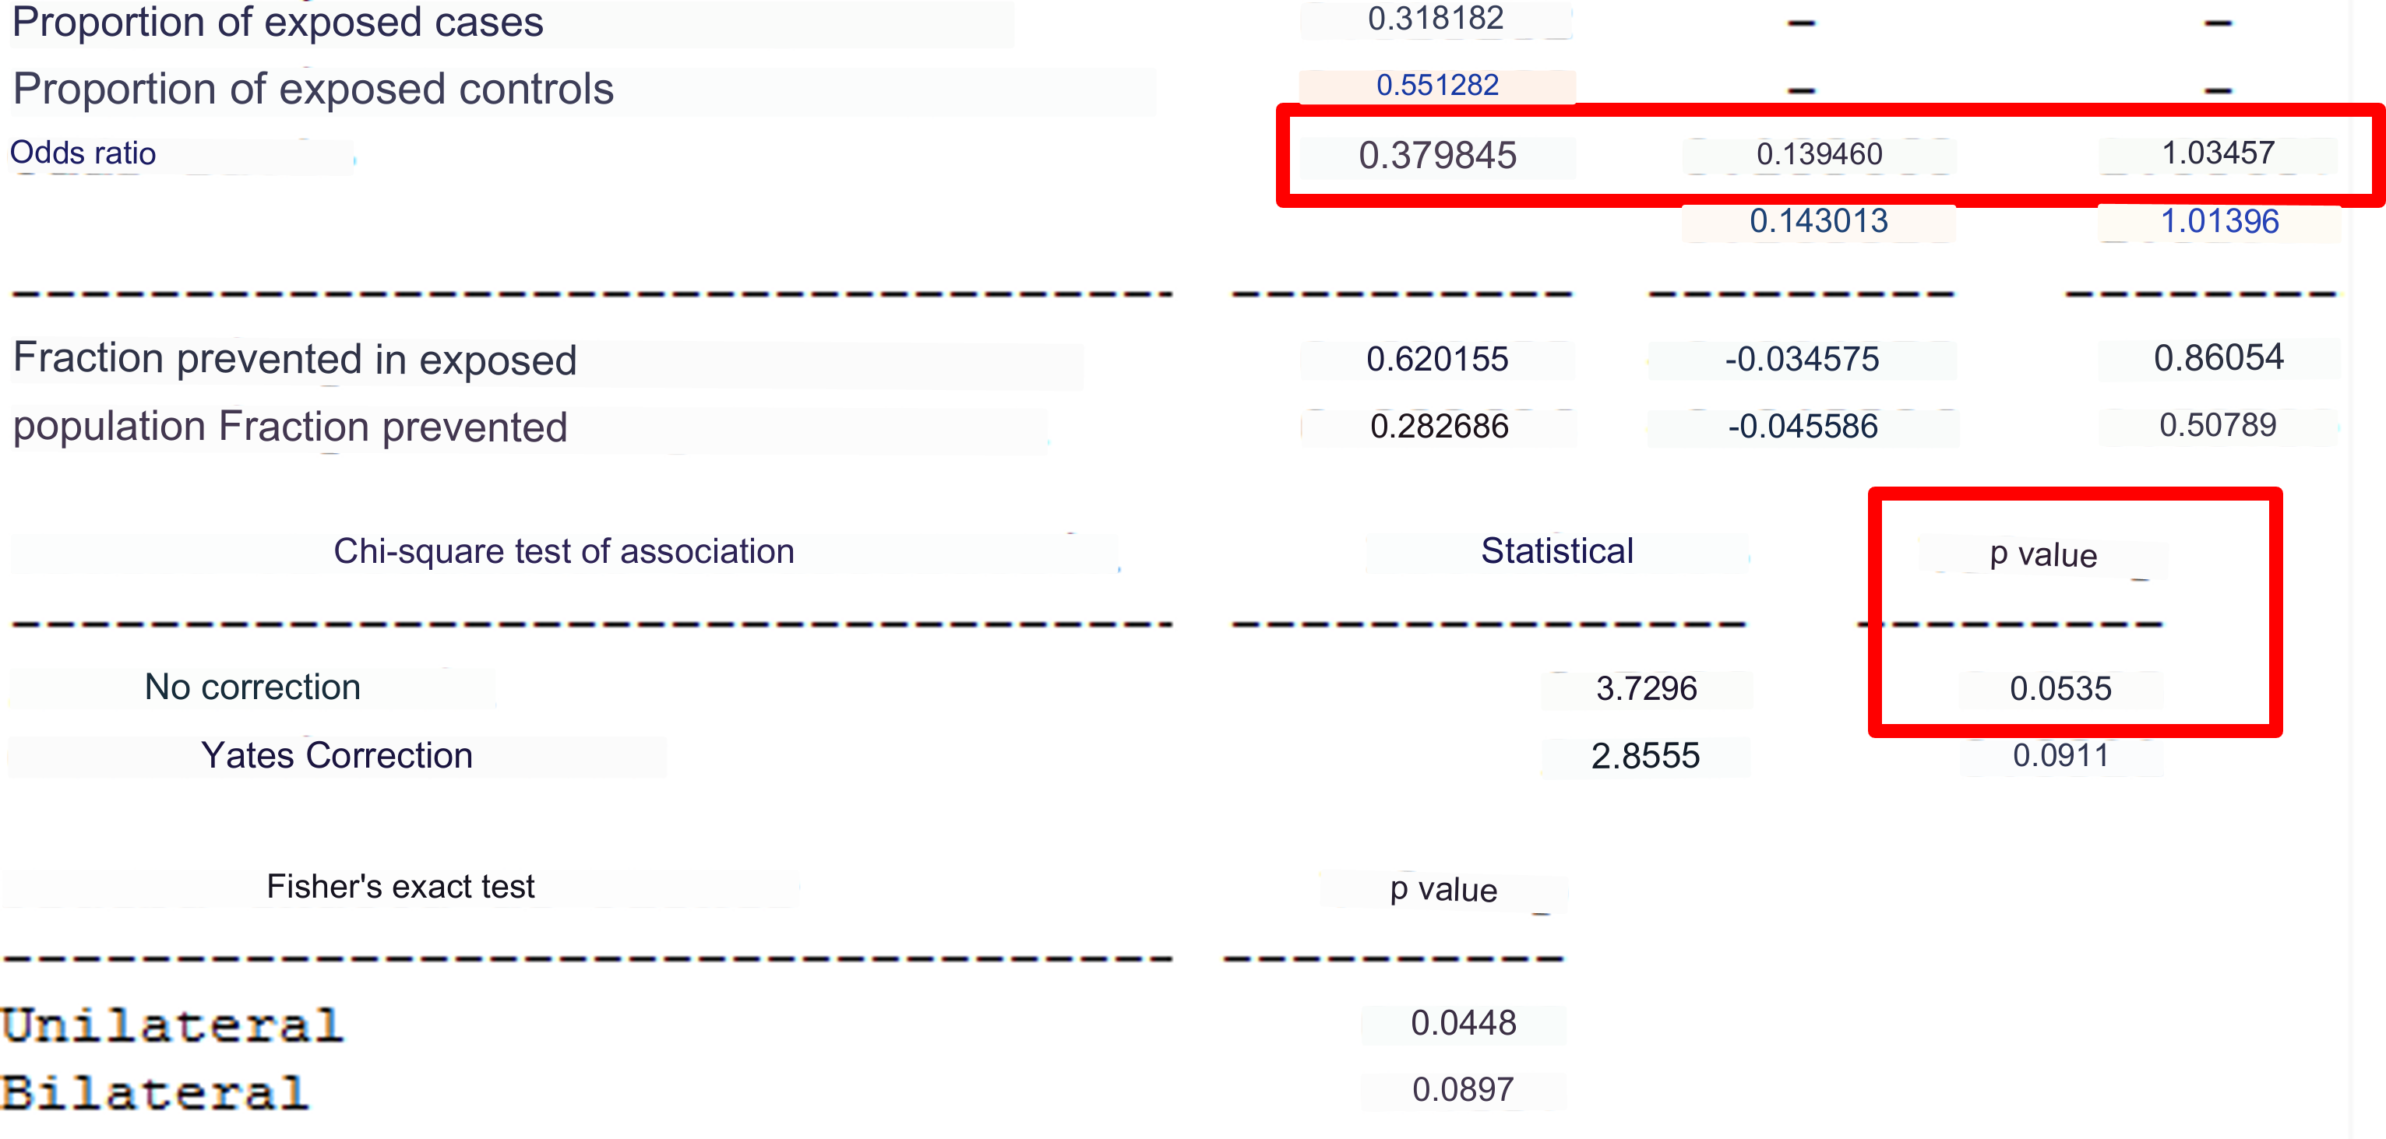
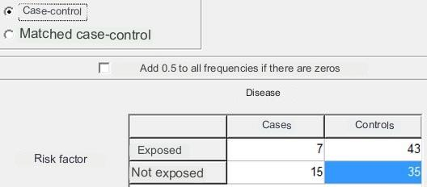
Case-control study

Slide 23
Interpreting results
Odds ratio
0.14
0.38
1.03
What can we conclude?
0
1
∞
Value p = 0.053, coincides with the interpretation of a confidence interval that includes 1

Slide 24
If various exposures are associated with the disease
Examples: foods consumed together, practices associated with one another, multiple contaminations
It is also important to determine in advance if there are various sources, mechanisms, or etiologies, or only one
Stratified or regression analysis is applied to determine whether both factors are associated with the disease or only one of them is

Slide 25
Consumption of salad and meat associated with gastroenteritis
90/259 (35%) of attendees at a wedding present with gastroenteritis. The incident is studied as a retrospective cohort
Two foods are statistically associated:
– Meat: RR=2.65, IC=[1.97-3.58], p<0.001
– Salad: RR=2.09, IC=[1.53-2.87], p<0.001
We suspect that the meat was contaminated but the salad was not; they are always eaten together
We need to discard the possibility that the salad caused the outbreak

Slide 26
Consumption of salad and meat associated with gastroenteritis
Salad
Meat

Slide 27
General strategy
In a disease associated with two factors, we must see which factor has a weak association and which is stronger. We seek to demonstrate that there is only an association with the strong factor but not with the weak one.
Therefore, we need to “control” or “cancel” the effect of the strong factor and then see if the weak factor is still associated with the disease
To do that, we stratify two groups based on the strong factor, and in each group, we independently evaluate if the weak factor is associated with the disease or not
If in both strata the weak factor is not associated with the disease, then it is not associated in general, and we can conclude that the strong factor caused the outbreak

Slide 28
In our example
We want to demonstrate that the salad (weak factor) is not associated with the outbreak, but the meat (strong factor) is
If we “control” the association between the meat and the outbreak, the salad should not have an effect
We will see the effect of the salad in two strata:
– Only in people who ate the meat
– Only in people who did NOT eat the meat
If the salad no longer has an effect once the strata are separated, then it was probably never associated, and the outbreak was caused by the meat

Slide 29
Stratified by salad consumption
Meat
Stratum 1:
Those who ate meat (n=60, 40 cases)
Stratum 2:
Those wo did not eat meat (n=199, 50 cases)
The data needed to conduct the stratified analysis cannot be obtained directly from the tables shown previously
To obtain the data necessary for the stratified analysis, we need to cross-check the variables (disease vs. salad consumption) in each of the two strata (meat or no meat)

Slide 30
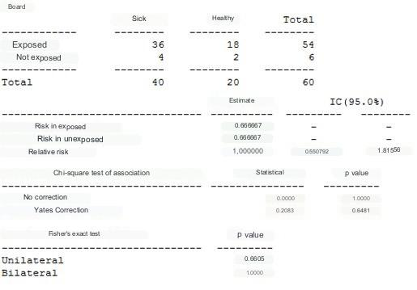
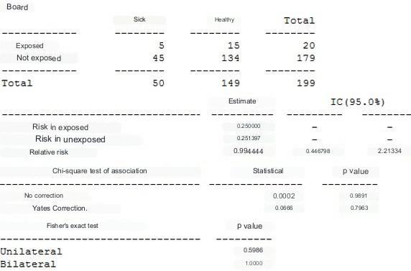
No association is observed between the salad and gastroenteritis if we separately analyze those who ate meat and those who did not
Those who ate meat
(n=60)
Those who did NOT eat meat
(n=199)

Slide 31
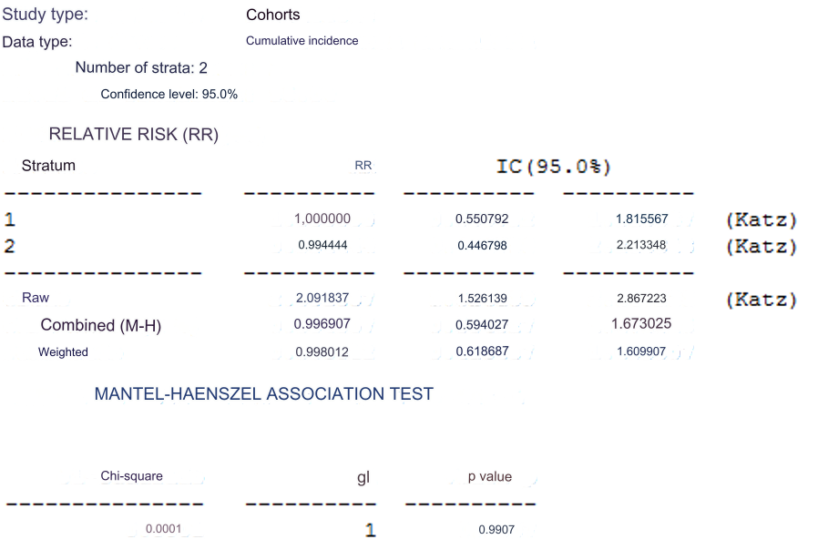
Association between gastroenteritis and salad stratified by meat
1 = Ate meat
2 = Did not eat meat
|
The association disappears, becomes insignificant
|

Slide 32
Stratified analysis
Useful to discern between two factors that appear to be associated with a disease
Can be complicated as sometimes the differences between groups are not very clear
Multiple regression is a more complex approach
In outbreak studies, the size of the sample limits the use of statistical tests in stratification

Slide 33
Interpreting results
What does a difference or significant association mean?
How do we interpret the lack of association?
To what can it be attributed?
What is the role of the results of vector, reservoir, environmental, etc. studies?
How do we interpret contradictory evidence?

Slide 34
Summary
The importance of correct interpretation of evidence
Incorporation of non-analytic results
Evidence is not discarded
Biological plausibility takes precedence over statistics

Slide 35
© Pan American Health Organization, 2023
Property of the Pan American Health Organization. Reproduced with permission pursuant to the Creative Commons Attribution-NonCommercial-NoDerivs 3.0 IGO license (CC BY-NC-ND 3.0 IGO).
In any use of this work, there should be no suggestion that the Pan American Health Organization (PAHO) endorses any specific organization, product, or service. Use of the PAHO logo, in a way that is not already incorporated in the work or consistent with the Creative Commons license CC BY-NC-ND 3.0 IGO, is strictly prohibited. Any use of this work that is inconsistent with or not permitted under the Creative Commons license BY-NC-ND 3.0 IGO requires the express written consent of PAHO.
Further, all reasonable precautions have been taken by PAHO and the GS/OAS to verify the information contained in this publication. However, the published material is being distributed without warranty of any kind, either expressed or implied. The responsibility for the interpretation and use of the material lies with the reader. In no event shall PAHO and/or the OAS or GS/OAS be liable for damages arising from its use

