Slide 1
Safety, occupational health, and biosecurity in the field

Slide 2
Objectives
Identify safety aspects to consider before conducting any field work
Anticipate occupational safety issues among field personnel
Use this presentation as a guide for personnel health and safety issues

Slide 3
Content
Field work safety
Occupational health
Biosecurity

Slide 4
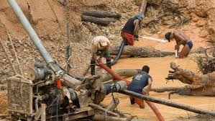
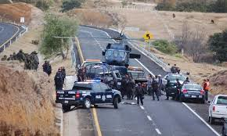
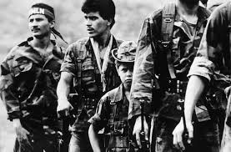
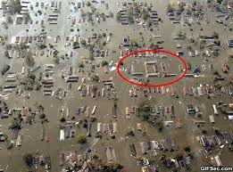
Safety in the field
Before heading to an outbreak zone:
Verify the zone’s safety
Consider:
– Armed groups
– Disaster zones
– Drug trafficking or other illegal activities
– General delinquency
www.taringa.net
www.monografias.com
www.itcilo.org
www.ntrzacatecas.com

Slide 5
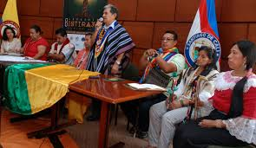
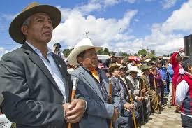
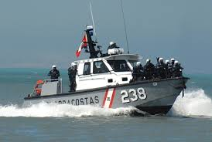
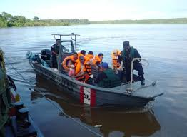
Safety in the field
Before heading to an outbreak zone:
Contact the relevant authorities:
– Local authorities or representatives
– Armed forces (police, army, navy, air force)
– Port authority
www.citycali.blogspot.com
www.es.wpf.org
www.dicapi.mil.pe
www.andina.com.pe

Slide 6
Safety in the field
Some recommendations:
Work at least in pairs
Communication protocol:
– Radio or cell phone is assigned to each work group
– Report when beginning and concluding work
– Report before traveling from the field work site or to the operations base
– Establish an alarm signal and response protocol
Notes:
If the alarm signal is used, the response protocol should be activated. This may include contacting the team that activated the alarm to understand the situation. If there is no response, or if circumstances warrant, local law enforcement should be contacted in order to locate the team on alert.

Slide 7
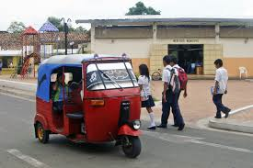
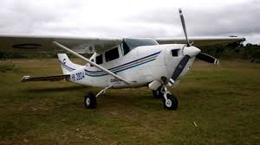
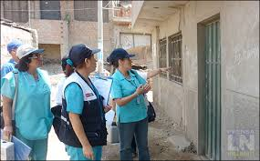
Safety in the field
www.commons.wikimedia.org
Some recommendations:
Support from local personnel:
– Local health or community authorities
– Armed forces
Travel:
– Based on the recommendations of local partners
www.youtube.com
www.agenciadeprensalimanorte.com
Notes:
Normally support from health personnel or local volunteers is sufficient, but in some situations, it will be necessary to rely on support from the military, including for traveling to disaster zones or areas that are difficult to access.

Slide 8
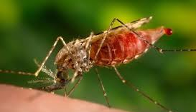
Occupational health
The field team should not add to cases
Before heading to the work zone:
– Identify health risks, including those not related to the outbreak
Malaria-endemic zone, accidents involving poisonous animals, climate conditions
This will be used for later risk assessments
www.vectorbase.org
www.theodisseyonline.com
www.nature.com

Slide 9
Occupational health
The team in the field should not add to cases
Before heading to the work zone:
– When putting together the team:
– Physical fitness
– Know specific personnel restrictions
– Appropriate training for activities and PPE use
– Evaluations before and after time in the field

Slide 10
Occupational health
Before heading to the work zone:
Vaccination:
– Up-to-date vaccination schedules
– Pre-exposure dose
Identify response centers:
– Hospital, anti-rabies center, civil defense center
Prepare a first-aid kit:
– Post-exposure prophylaxis
– Antiophidic serums
– Post-exposure vaccines available

Slide 11
Occupational health
Basic vaccination schedule:
– Based on country where you are working
– Based on requirements for working with biological fluids
Pre-exposure vaccination schedule based on work zone
Vaccinations or post-exposure prophylactic biological products:
– Should you take it with you?
– Are there accessible response centers in the work zone?

Slide 12
Examples of recommended vaccinations
Hepatitis B: in high-risk zones
Influenza
Measles, Mumps, and Rubella
Pertussis
Chicken pox
Meningococcus: every 5 years in high-risk groups
Pre-exposure anti-rabies
Yellow fever
Others depending on the local context
ACIP (2011). "Immunization of health-care personnel: recommendations of the Advisory Committee on Immunization Practices (ACIP)." MMWR. Recommendations and reports: Morbidity and mortality weekly report
Notes:
Hepatitis B
• HCP and trainees in certain populations at high risk for chronic hepatitis B (e.g., those born in countries with high and intermediate endemicity) should be tested for HBsAg and anti-HBc/anti-HBs to determine infection status.
Influenza
• Emphasize that all HCP, not just those with direct patient care duties, should receive an annual influenza vaccination • Comprehensive programs to increase vaccine coverage among HCP are needed; influenza vaccination rates among HCP within facilities should be measured and reported regularly.
Measles, mumps, and rubella (MMR)
• History of disease is no longer considered adequate presumptive evidence of measles or mumps immunity for HCP; laboratory confirmation of disease was added as acceptable presumptive evidence of immunity. History of disease has never been considered adequate evidence of immunity for rubella.
• The footnotes have been changed regarding the recommendations for personnel born before 1957 in routine and outbreak contexts. Specifically, guidance is provided for 2 doses of MMR for measles and mumps protection and 1 dose of MMR for rubella protection.
Pertussis
• HCP, regardless of age, should receive a single dose of Tdap as soon as feasible if they have not previously received Tdap.
The minimal interval was removed, and Tdap can now be administered regardless of interval since the last tetanus or diphtheria-containing vaccine.
Hospitals and ambulatory-care facilities should provide Tdap for HCP and use approaches that maximize vaccination rates.
Varicella
Criteria for evidence of immunity to varicella were established. For HCP they include • written documentation with 2 doses of vaccine, • laboratory evidence of immunity or laboratory confirmation of disease, • diagnosis of history of varicella disease by healthcare provider, or diagnosis of history of herpes zoster by healthcare provider.
Meningococcal
• HCP with anatomic or functional asplenia or persistent complement component deficiencies should now receive a 2-dose series of meningococcal conjugate vaccine. HCP with HIV infection who are vaccinated should also receive a 2 dose series.
• Those HCP who remain in groups at high risk are recommended to be revaccinated every 5 years.

Slide 13
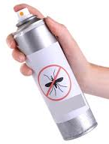
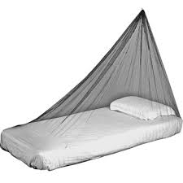
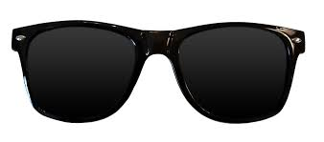
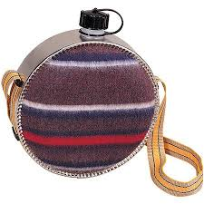
Occupational health
Work clothes and appropriate accessories:
Solar radiation: UV protection, hat and clothes with UV filter, sunglasses with UV filter
High temperature: water bottles
Presence of vectors: repellents, long-sleeved clothes, screens
Notes:
Everything that can ensure your physical integrity should be considered, from sun protection to possible vectors.

Slide 14
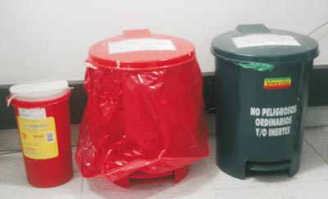
Biosecurity
Basic personal protection equipment (PPE)
Standard procedures for using PPE
– Protocol for putting on and REMOVING PPE
– Review PPE function
Standard procedures for cleaning PPE
Procedure for discarding PPE

Slide 15
Biosecurity
Basic PPE
* Based on field conditions, may not be necessary

Slide 16
Biosecurity
PPE for special situations (BSL-3):
Aerosol transmission (e.g., Hantavirus)
– Requires the use of respirators
Transmission by highly infectious fluids (e.g., Filovirus)
– Requires surface coverage
Notes:
Item
Heavy duty apron
Recommendation 9
Waterproof boots
Recommendation 10
Hood or headcover
Recommendation 11
Surgical scrubs: trousers and top
Technical specifications
Heavy duty non-woven apron
Straight apron with bib
Fabric: 100% polyester with PVC coating, or 100% PVC, or 100% rubber, or other fluid resistant material (e.g. rubber, PVC)
Waterproof, sewn strap for neck and back fastening
Minimum basis weight: 300g/m2
Covering size: approximately 70-90cm width x 120cm-150cm height
Reusable (provided appropriate arrangements for decontamination are in place)
Nonslip, have a PVC sole which is completely sealed
Knee-high, in order be higher than the bottom edge of the gown
Optional light color to better detect possible contamination
A variety of sizes to improve comfort and avoid trauma to the feet
Single use
Preferably fluid resistant
Adjustable and immovable once adjusted
Facial opening constructed without elastic, reaching the upper part of the gown or coverall
Surgical scrubs are for use as regular on-duty wear and are not considered PPE. Details are provided for ease of procuring these items. Scrubs are preferable to street clothes while the health worker is on-duty.
Tightly woven
Minimum linting
Non-sterile, reusable or single use
Top/tunic: short sleeves
Trousers: drawstring waist enclosure
Different sizes

Slide 17
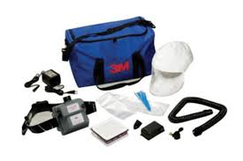
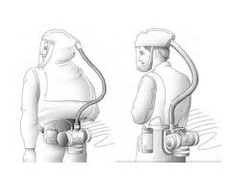
Biosecurity
Aerosol transmission (e.g. Hantavirus)
www.airgas.com
http://www.nap.edu/read/18990/chapter/3#8

Slide 18
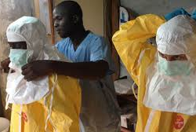
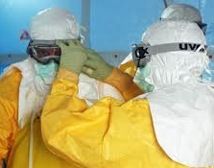
Biosecurity
Transmission by highly infectious fluids (e.g. Filovirus)
www.mamaye.org
www.globalbiodefense.com
Notes:
Notice how entering the Ebola patient care units is also done in pairs. They must be together at all times, and there is a time limit for how long they can stay in the service to prevent mistakes due to exhaustion or dehydration.

Slide 19
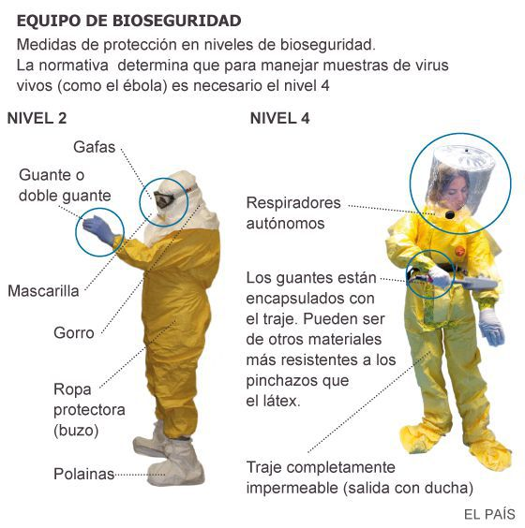
Biosecurity
BIOSECURITY EQUIPMENT
Protection measures in biosecurity levels.
Regulations determine that to handle live virus samples
(such as Ebola), level 4 is necessary.
LEVEL 2
LEVEL 4
Goggles
Gloves or double gloves
Self-contained breathing apparatus
Mask
The gloves are encapsulated with the suit. They can be made of materials more resistant to punctures than latex.
Cap
Protective clothing (coverall)
Gaiters
Fully waterproof suit
(shower on exit)

Slide 20
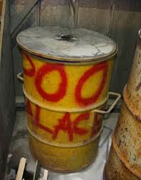
Biosecurity
Procedure for disposing of contaminated material, disposable PPE, and sharp objects:
Disposal in the field:
– Treatment at local health services
– Incineration
Transport:
– Safety
– Point of treatment
www.antarctica.gov.au
Notes:
The image you see is a field incinerator.

Slide 21
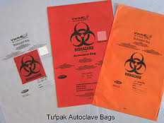
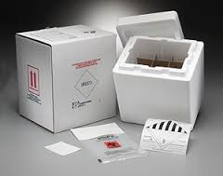
Biosecurity
Procedure for transporting samples:
Appropriate packing
Labels, forms, and permits
Requirements for mode of transport and transport company
Reception and entry at destination

Slide 22
© Pan American Health Organization, 2023
Property of the Pan American Health Organization. Reproduced with permission pursuant to the Creative Commons Attribution-NonCommercial-NoDerivs 3.0 IGO license (CC BY-NC-ND 3.0 IGO).
In any use of this work, there should be no suggestion that the Pan American Health Organization (PAHO) endorses any specific organization, product, or service. Use of the PAHO logo, in a way that is not already incorporated in the work or consistent with the Creative Commons license CC BY-NC-ND 3.0 IGO, is strictly prohibited. Any use of this work that is inconsistent with or not permitted under the Creative Commons license BY-NC-ND 3.0 IGO requires the express written consent of PAHO.
Further, all reasonable precautions have been taken by PAHO and the GS/OAS to verify the information contained in this publication. However, the published material is being distributed without warranty of any kind, either expressed or implied. The responsibility for the interpretation and use of the material lies with the reader. In no event shall PAHO and/or the OAS or GS/OAS be liable for damages arising from its use

